Slide 1
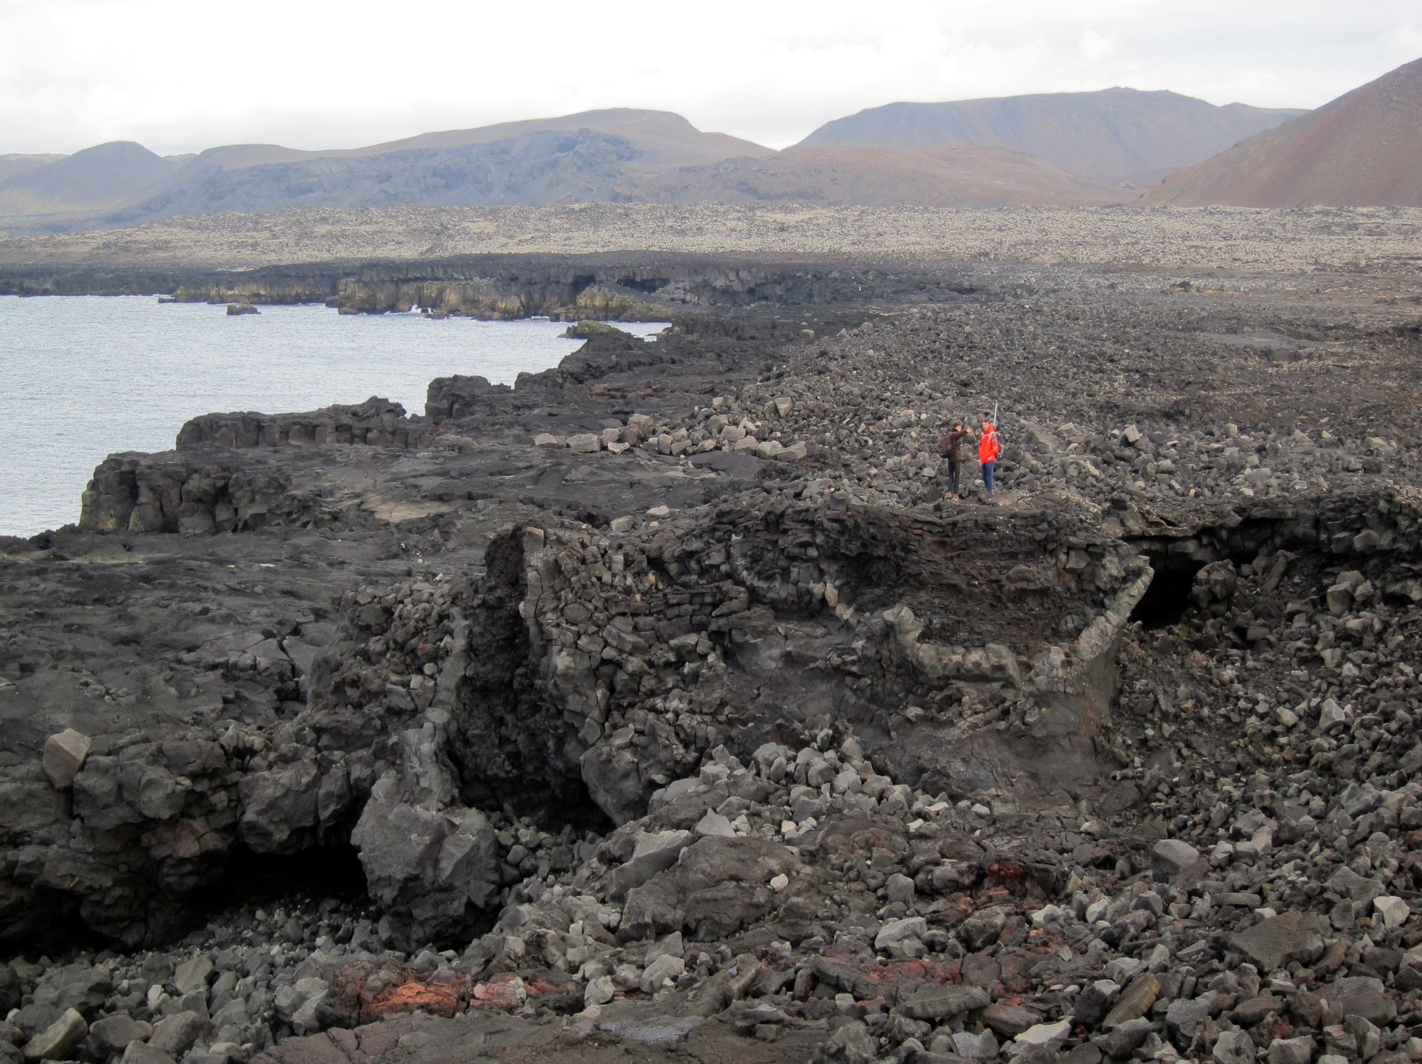











Projects EXTREMEVENT & EVEXTREMIS (IPEV)
Morphosedimentary signatures of extreme events on SW coast Iceland

Slide 2
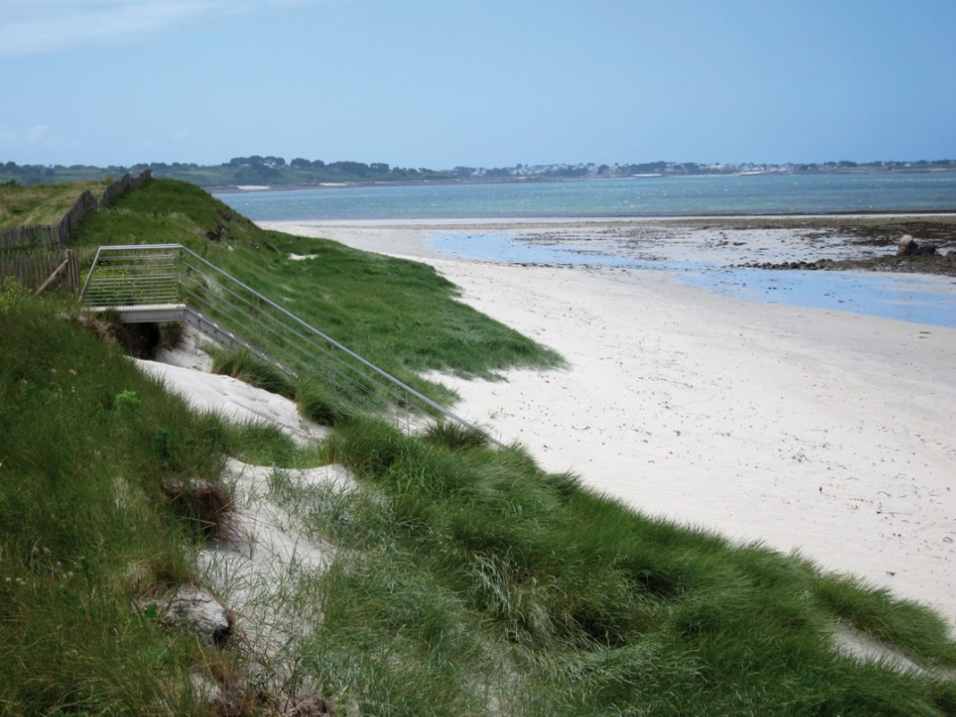
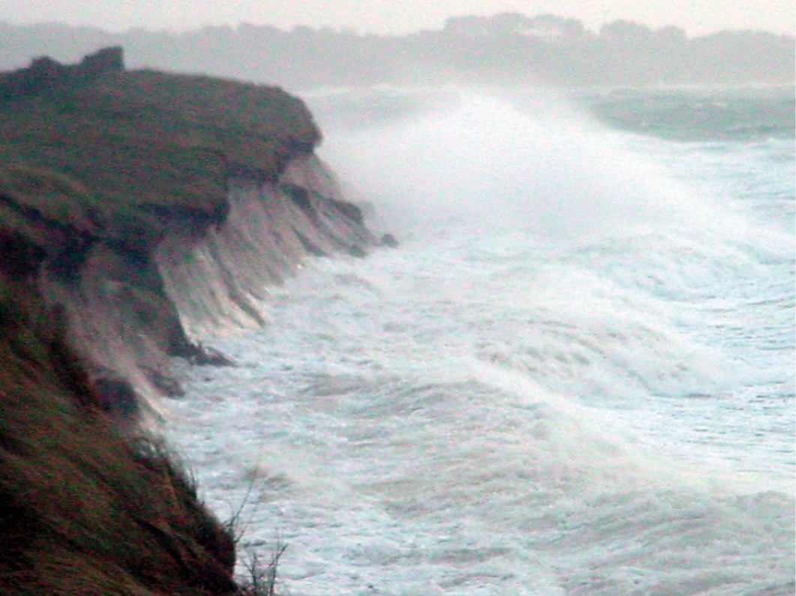
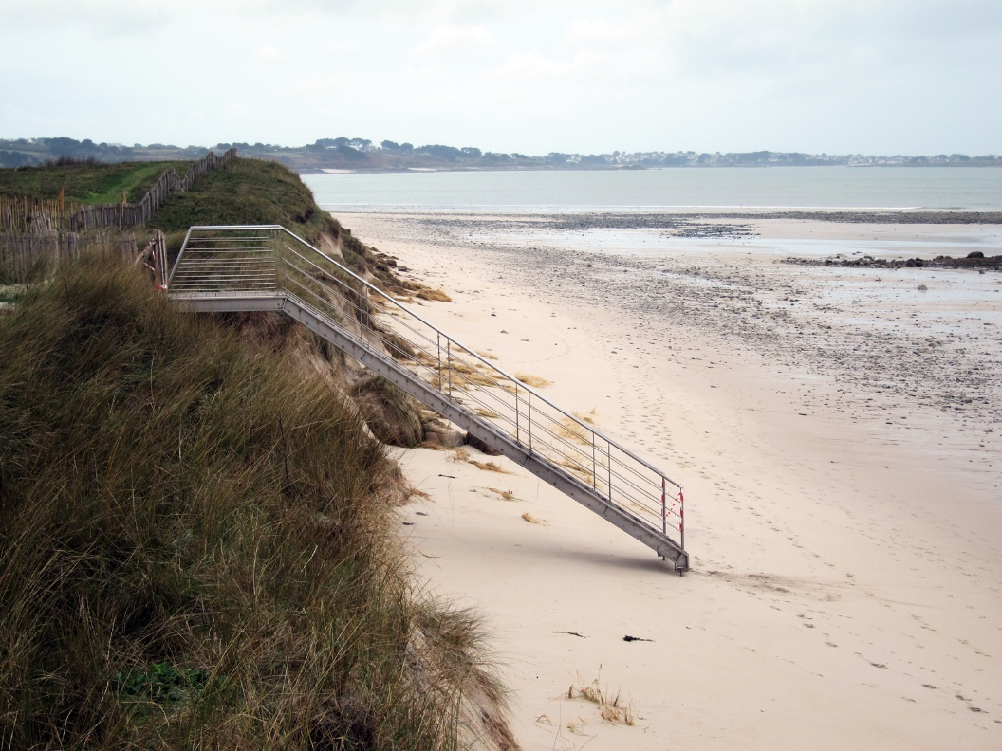
ante-storm
what is a morphosedimentary signature of an extreme event in geomorphology?
storm event
Vougot beach (north Finistère)
post-storm
⇒ the proxy here is the dune (or the shoreline) erosion

Slide 3
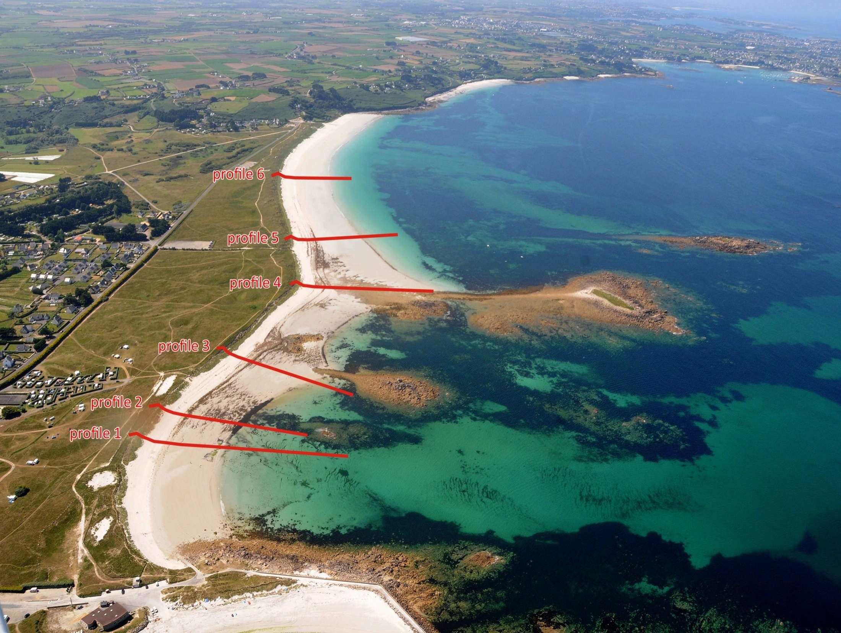
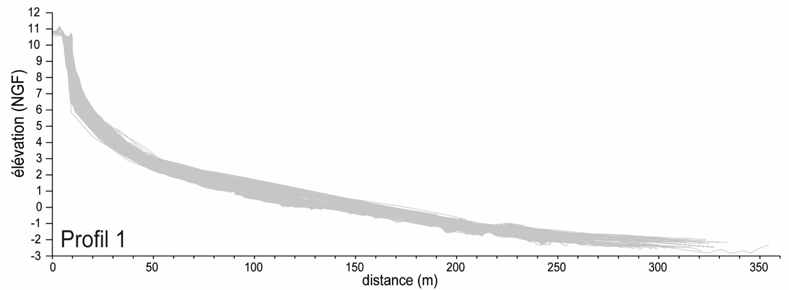
Morphological survey of the Vougot beach (North Finistère)
section dunaire
Plage du Vougot (North Finistère)

Slide 4
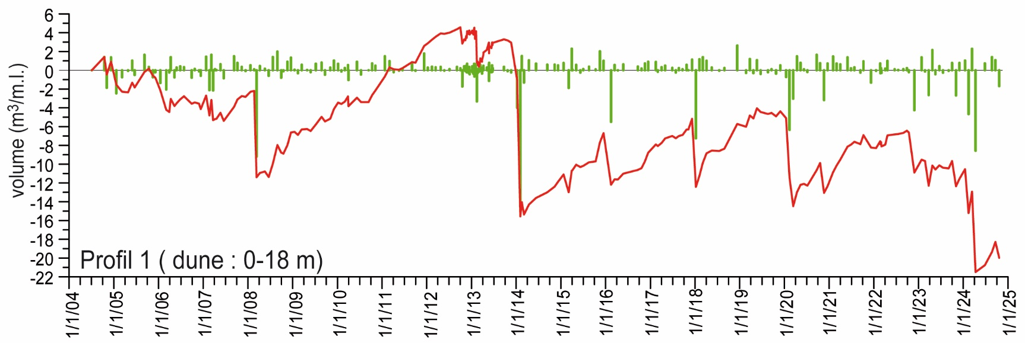
Morphological survey of the Vougot beach (North Finistère)
vers une augmentation des phénomènes érosifs
Plage du Vougot (North Finistère)

Slide 5
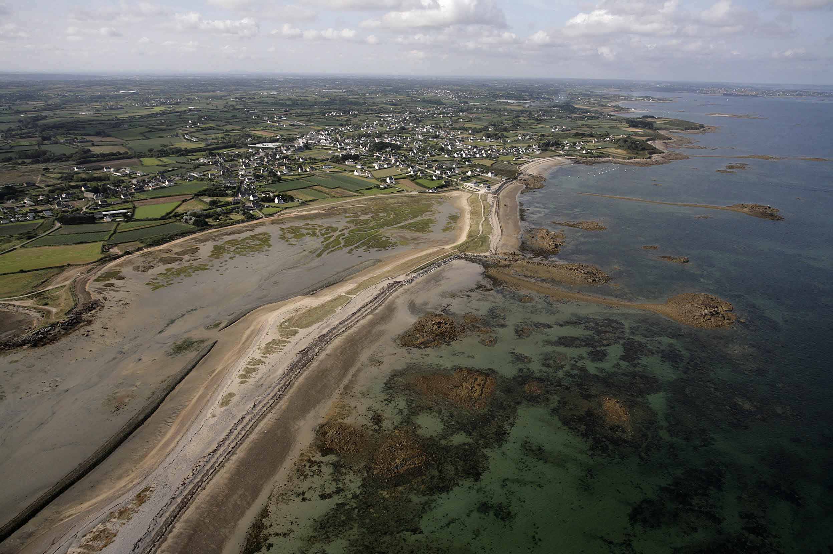
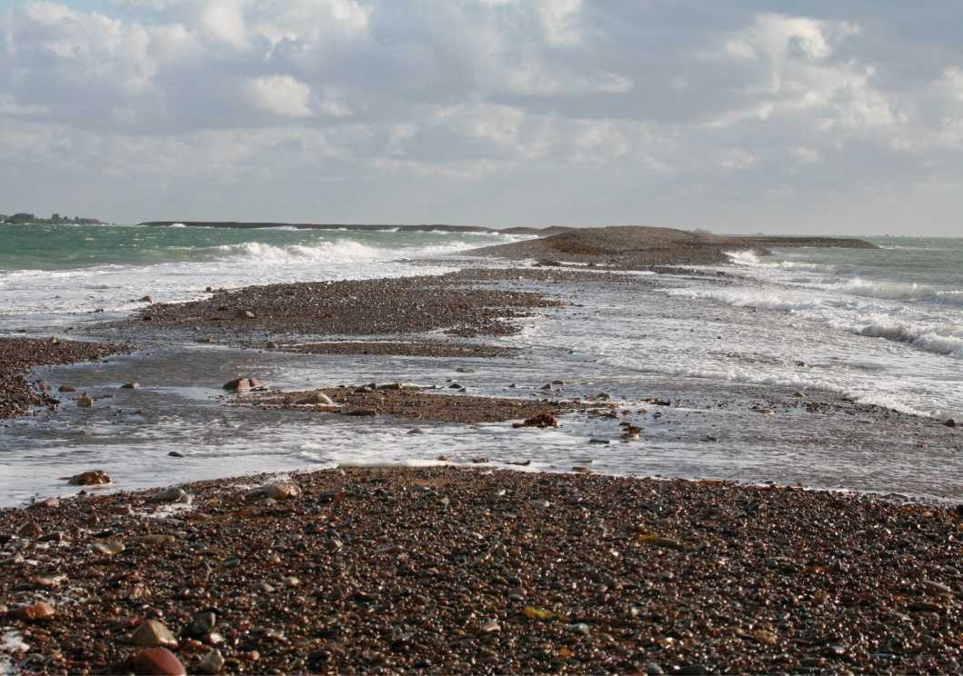
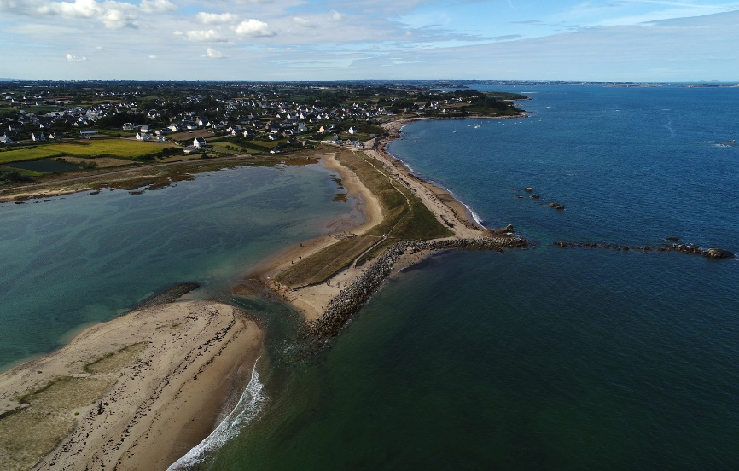
ante-storm
what is a morphosedimentary signature of an extreme event in geomorphology?
storm event
Sillon de Talbert (Côtes d’Armor)
post-storm
⇒ the proxy here is the landward barrier retreat (breaching)

Slide 6
Morphological survey of the Sillon de Talbert (Côtes d’Armor)

Slide 7
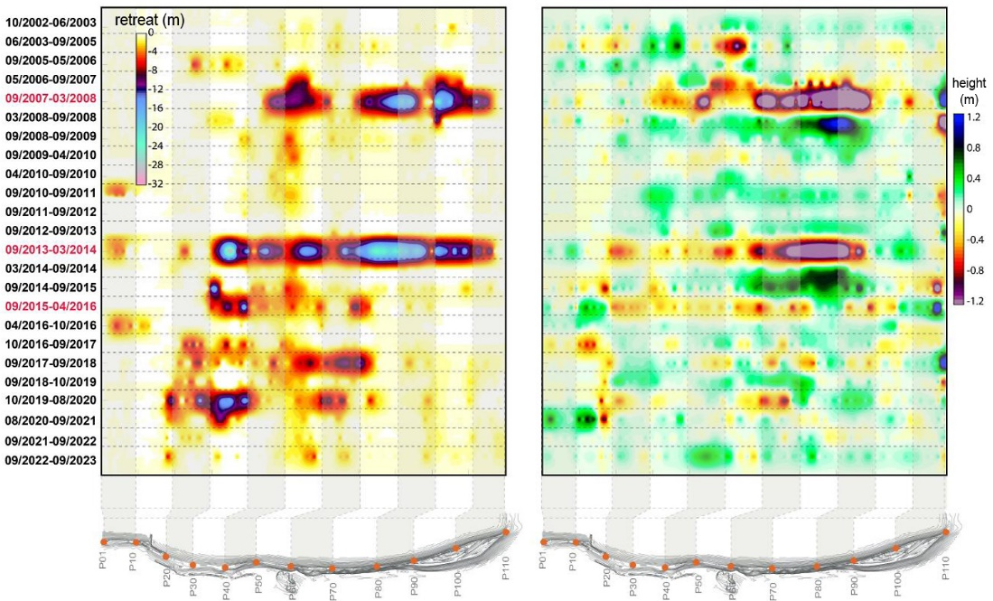
Morphological survey of the Sillon de Talbert (Côtes d’Armor)
spit retreat
crest elevation
towards an increase in the frequency of spit retreat ?

Slide 8
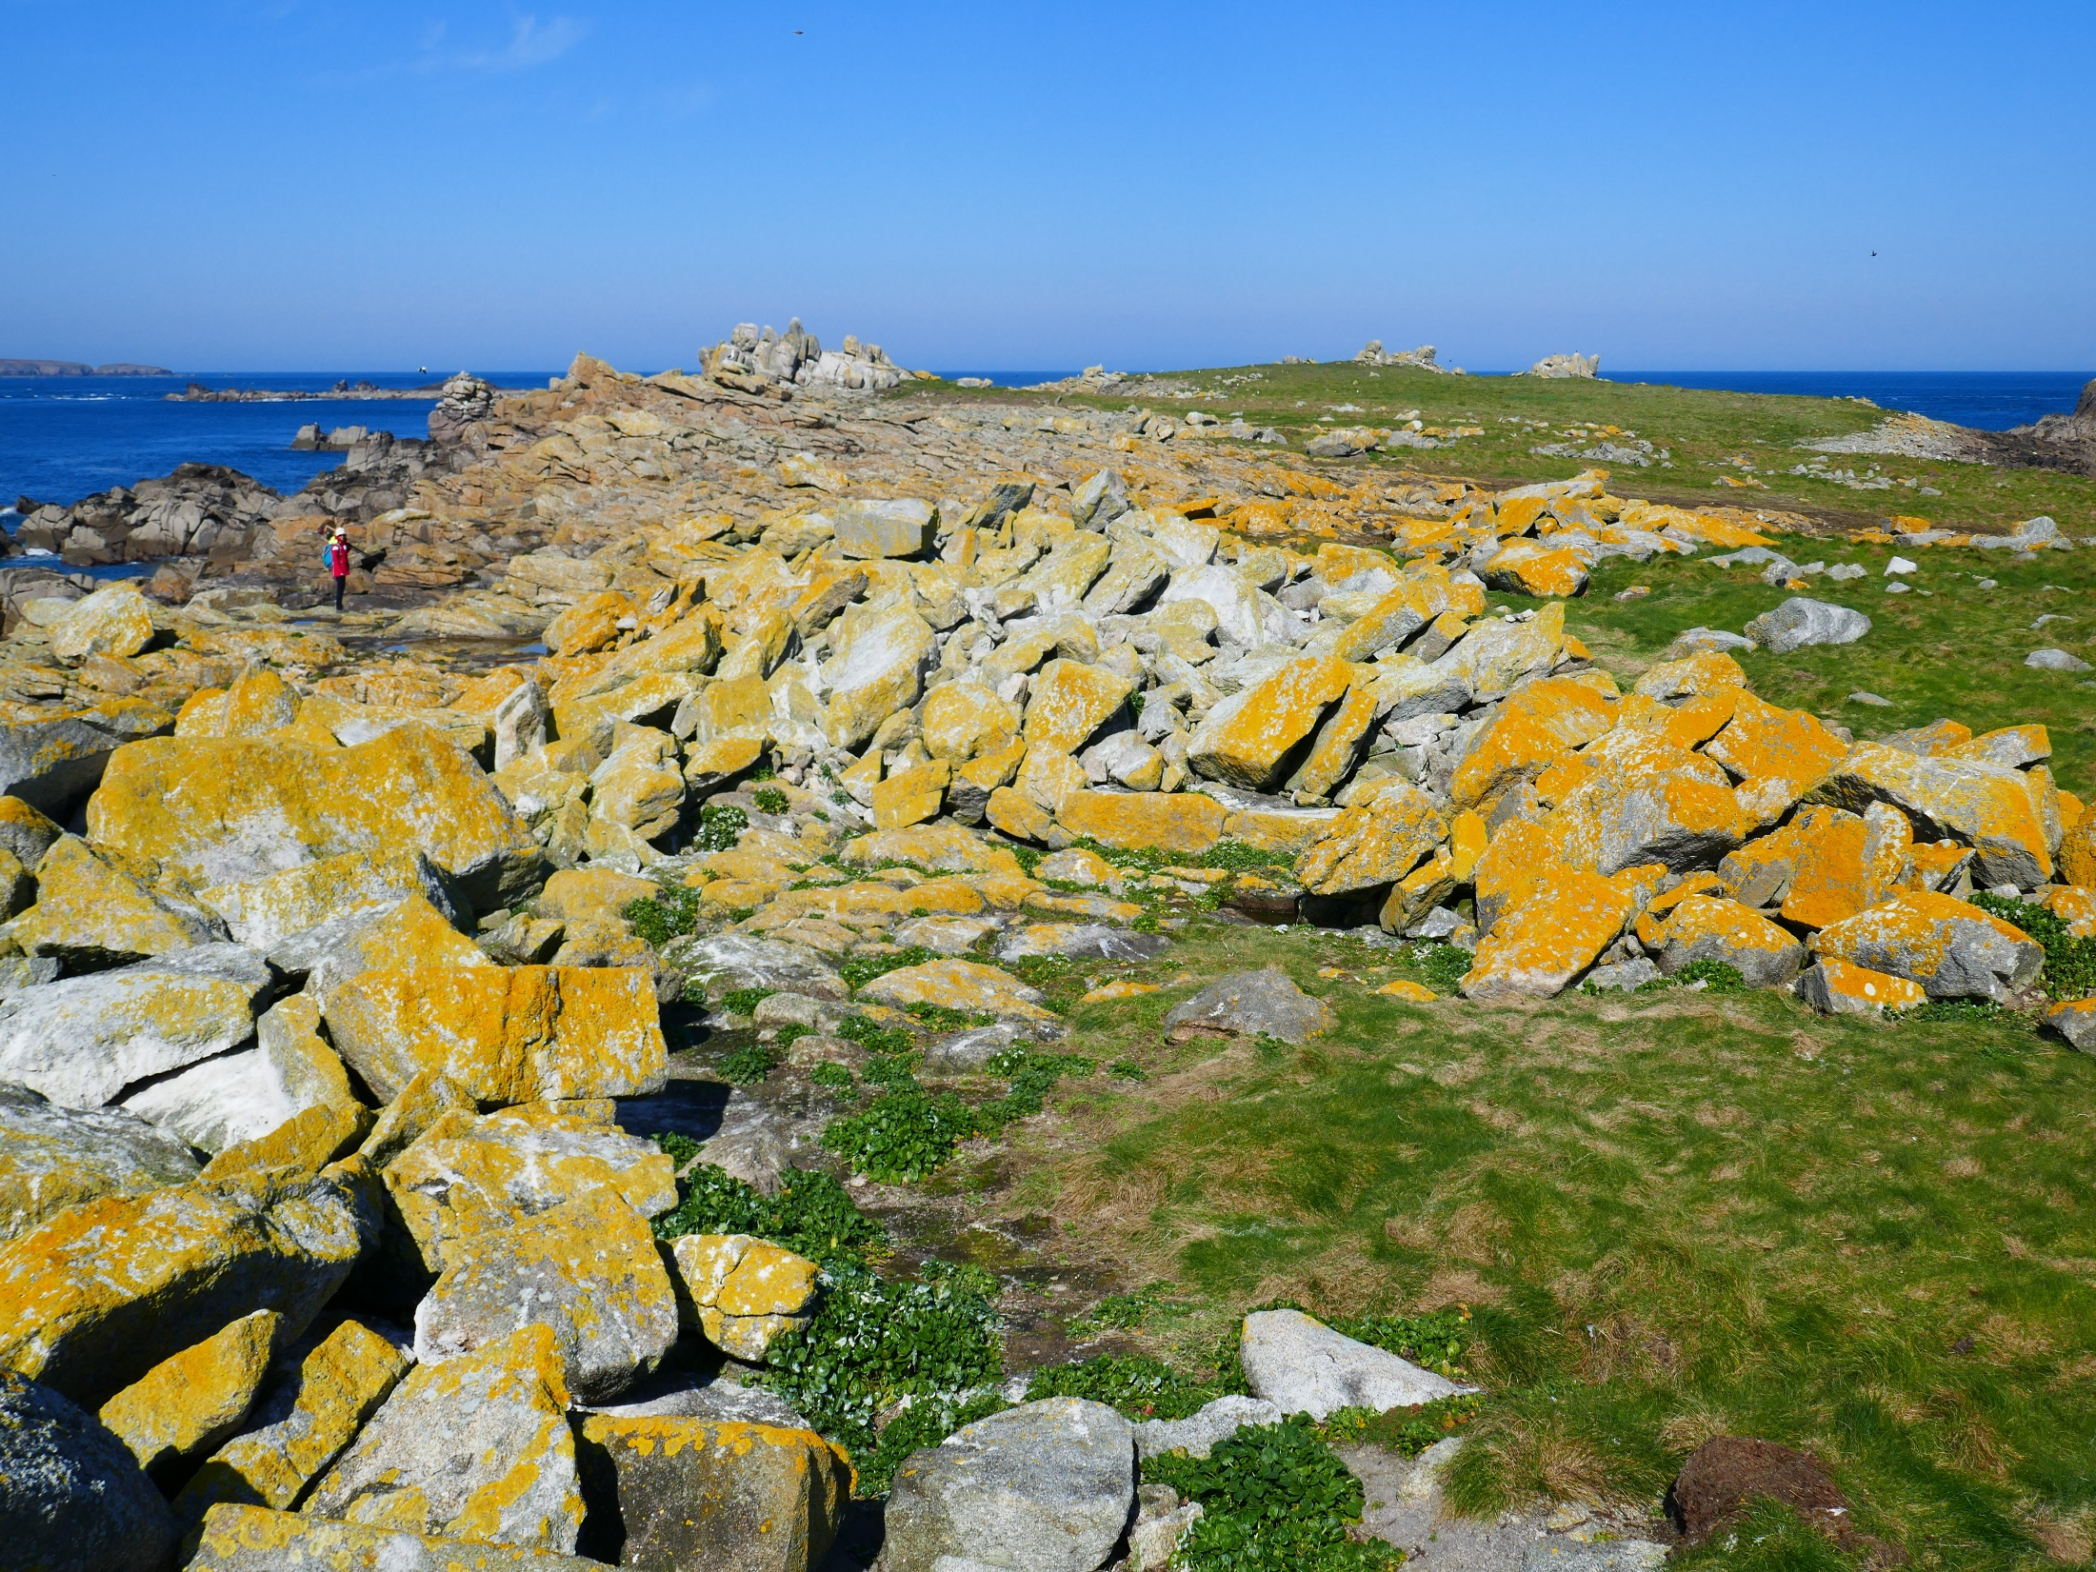
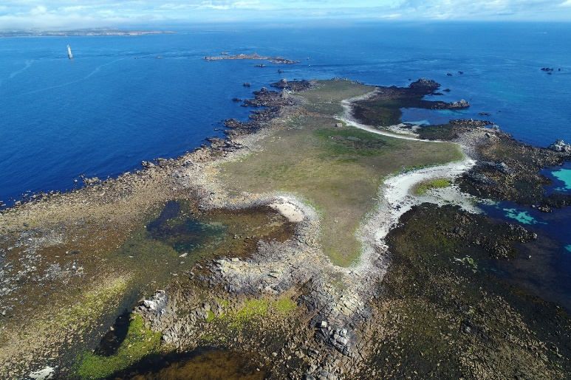
what is a morphosedimentary signature of an extreme event in geomorphology?
Banneg Island (west Finistère)
⇒ the proxy here is the coastal boulder deposits (CBD) activation

Slide 9
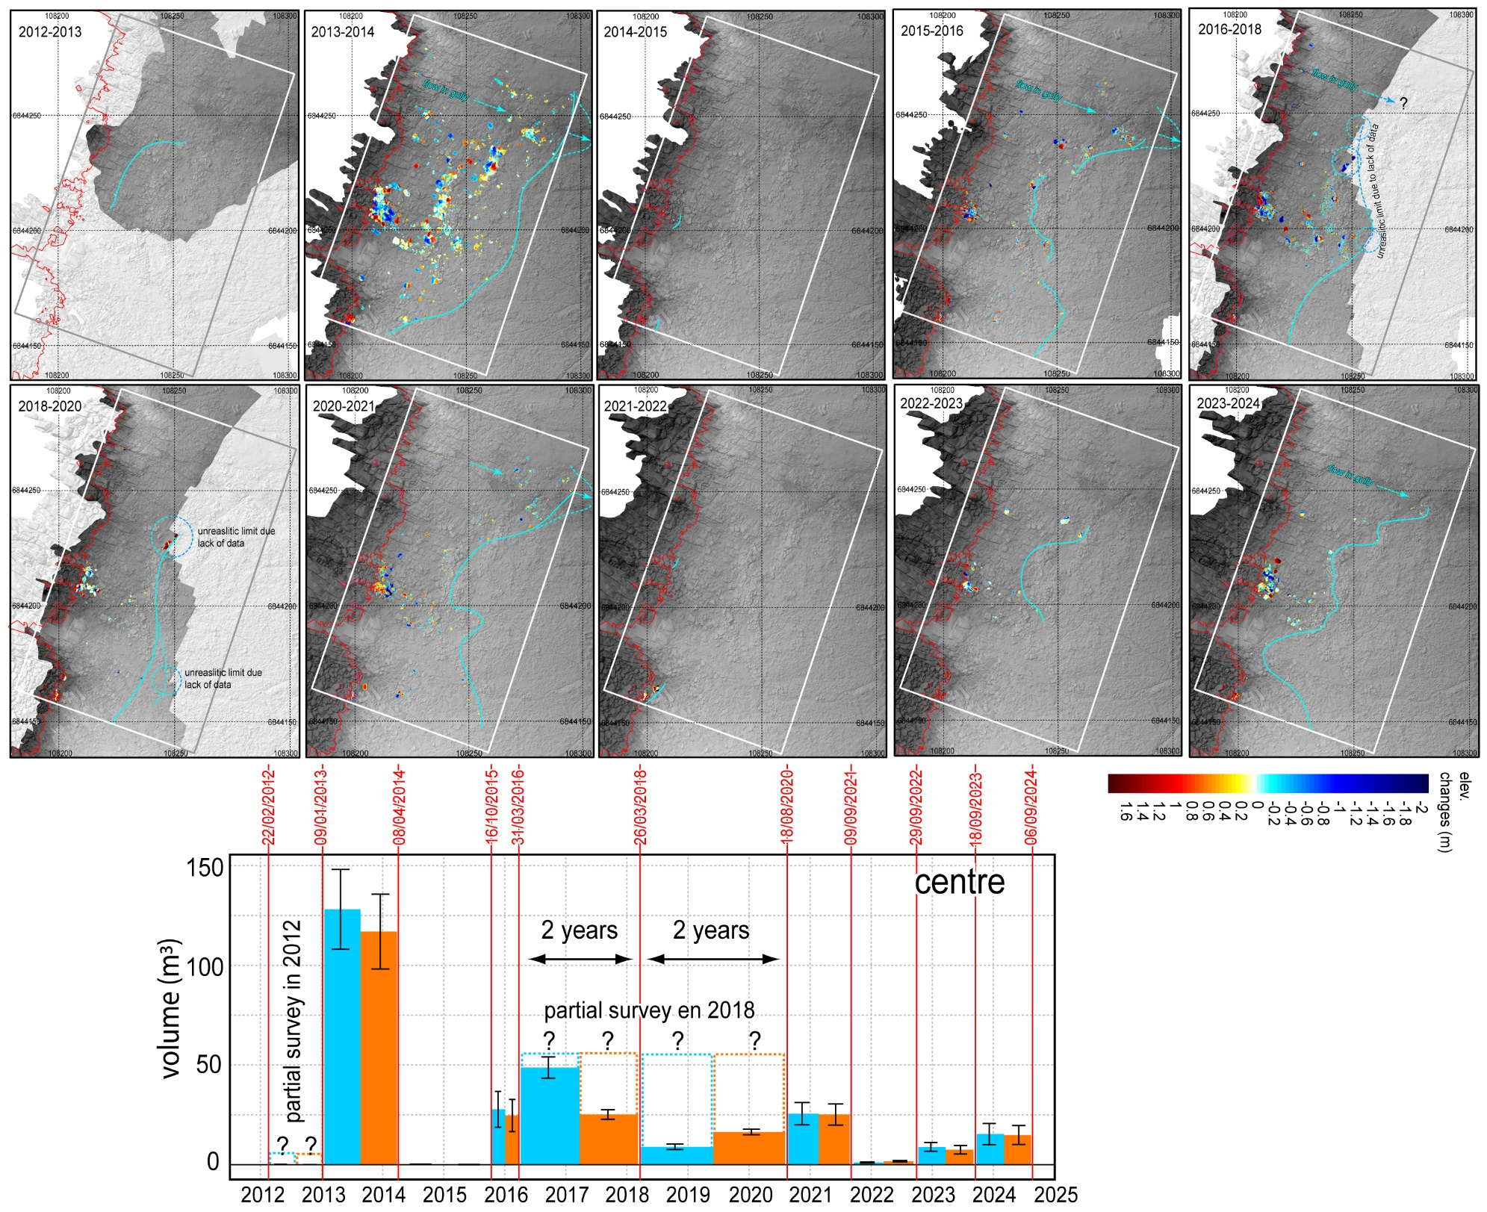

Slide 10
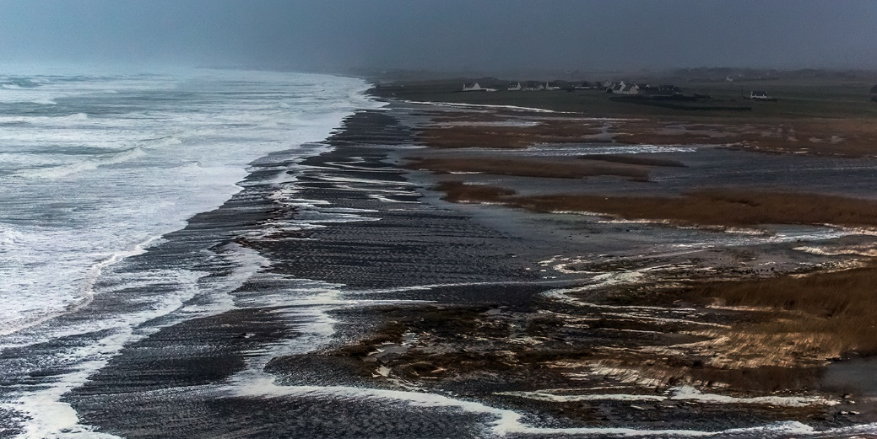
This survey has made it possible to define the timing and modalities of morphosedimentary changes in relation to variations in meteorological conditions, particularly extreme events, over the last two decades
morphogenetic event =
storm wave + high spring tide
source : Philip Plisson ©
Bay of Audierne (Petra storm of Feb. 5, 2014)

Slide 11
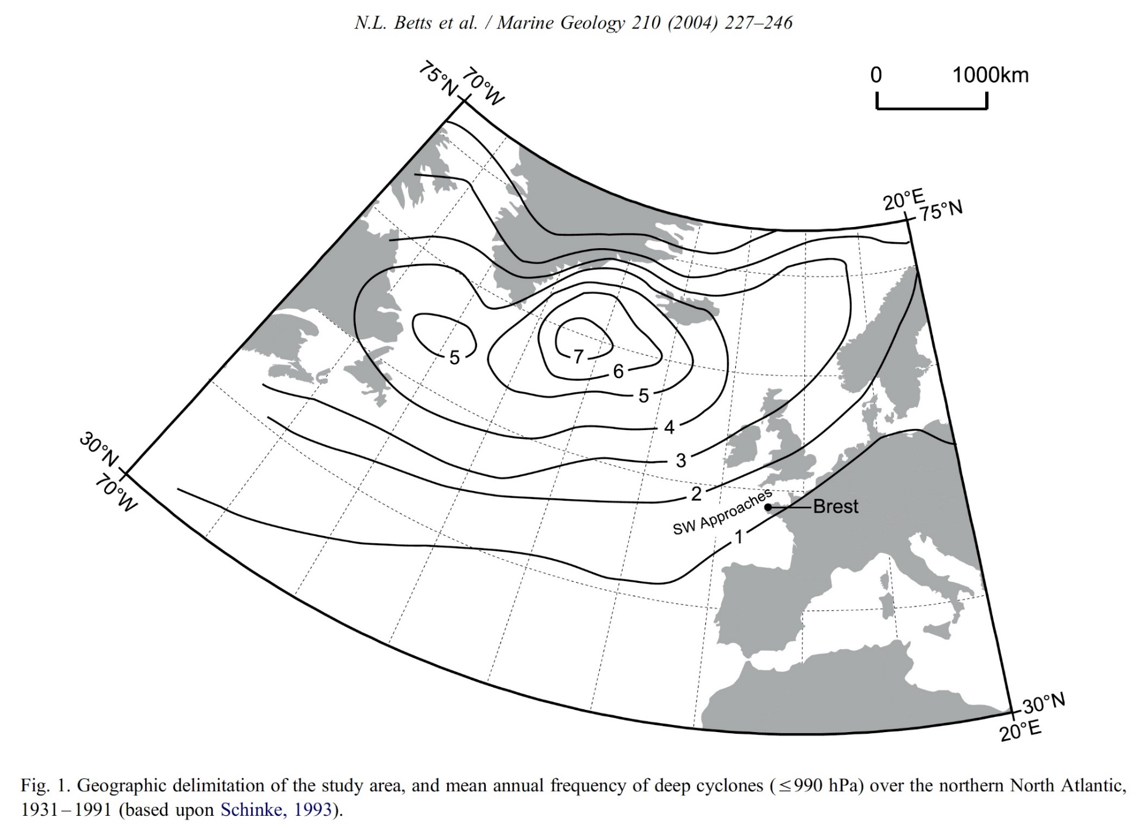
Why Iceland ?

Slide 12
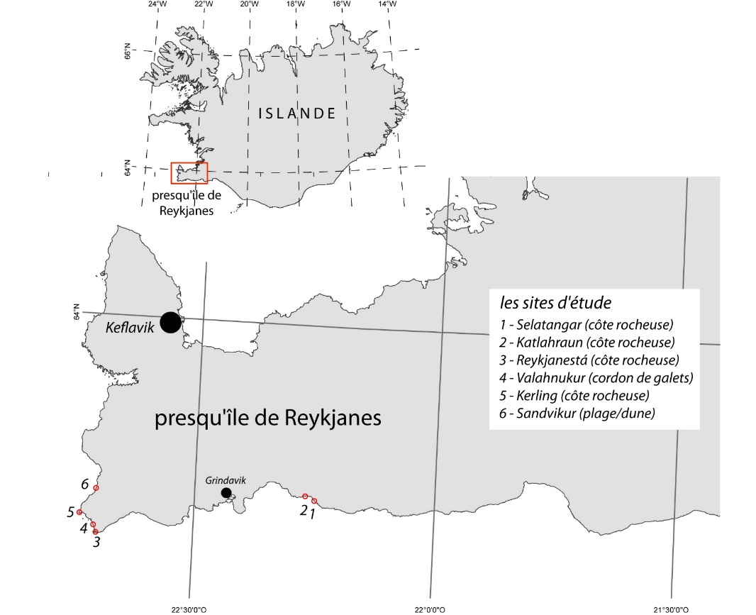
Setting up a morphosedimentary dynamics observatory
since 2014, survey of 6 sites has been undertaken:
4 rocky cliffs including CTSDs
1 mega-boulder barrier
1 beach/dune system
situated of the Reykjanes peninsula (SW Iceland)

Slide 13
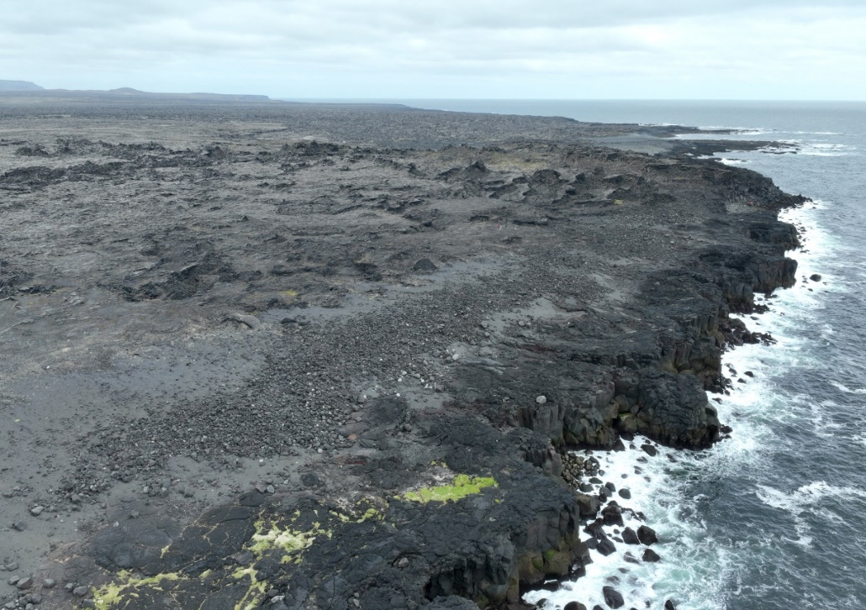
Site 1 - Selatangar (2023)

Slide 14
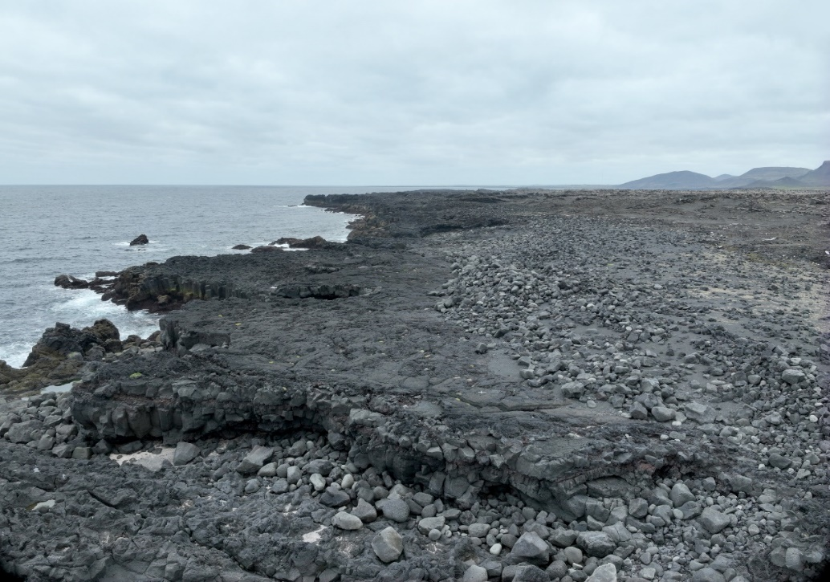
Site 2 - Katlarahun (2023)

Slide 15
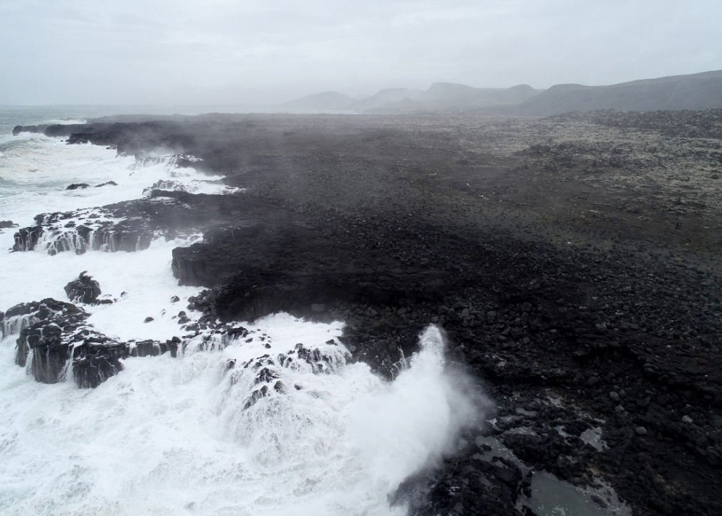
Site 2 - Katlarahun (2022)

Slide 16
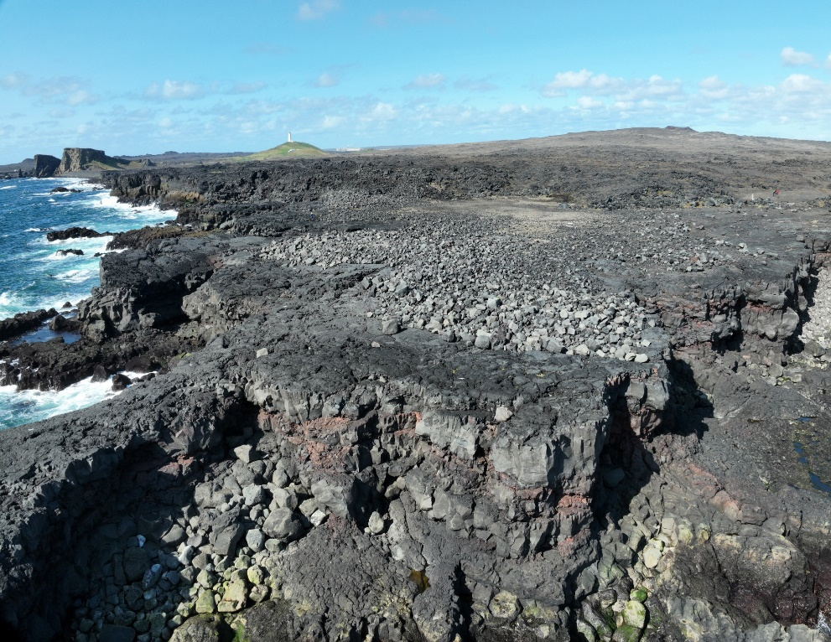
Site 3 - Reykjanesta (2023)

Slide 17
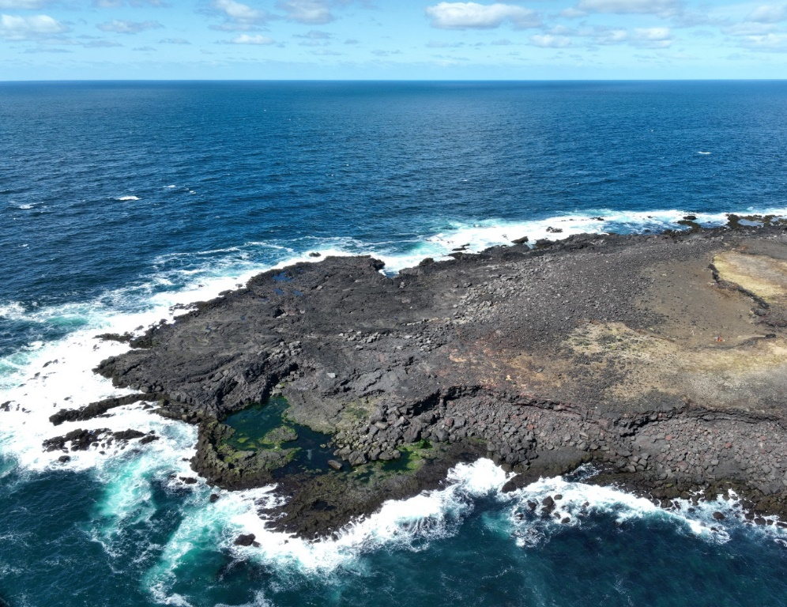
Site 4 - Kerling (2023)

Slide 18
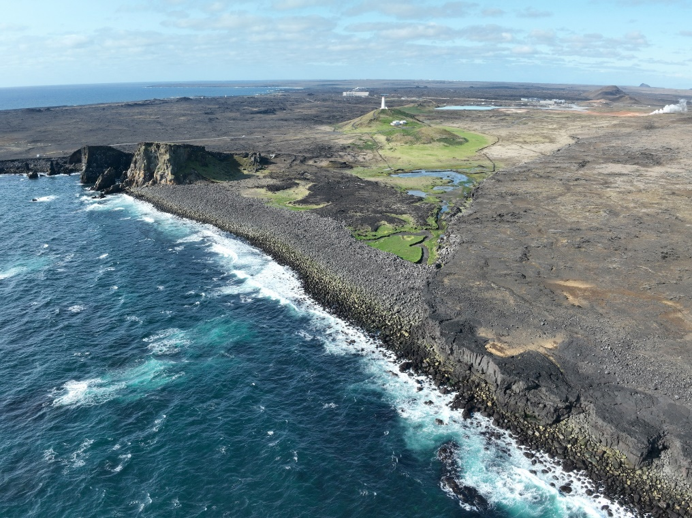
Site 5 - Valahnukur (2023)

Slide 19
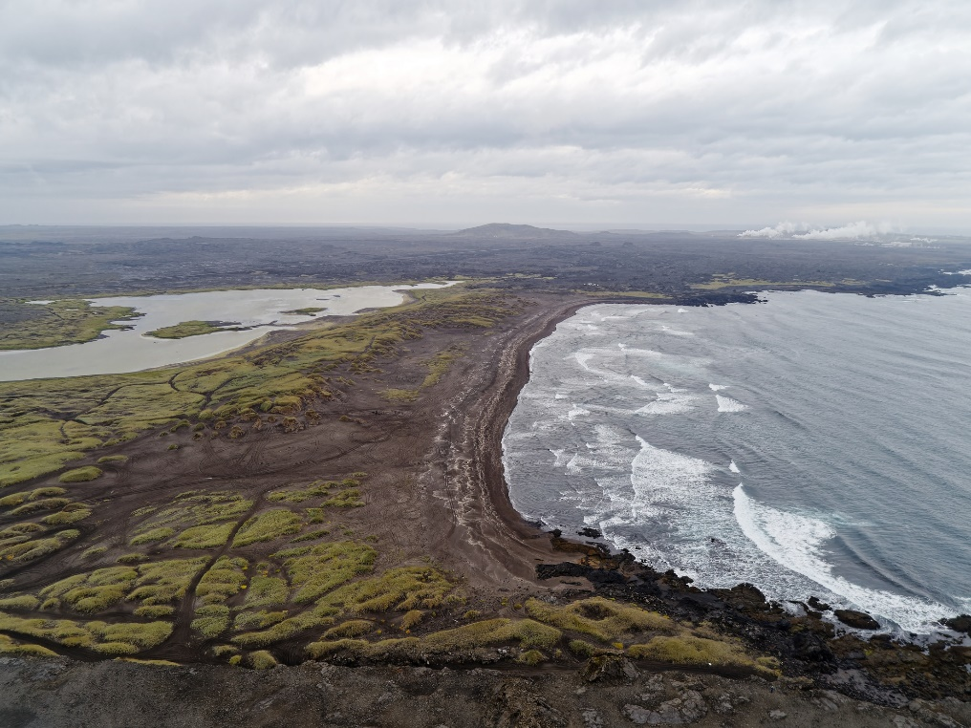
Site 6 - Sandvikur (2021)

Slide 20
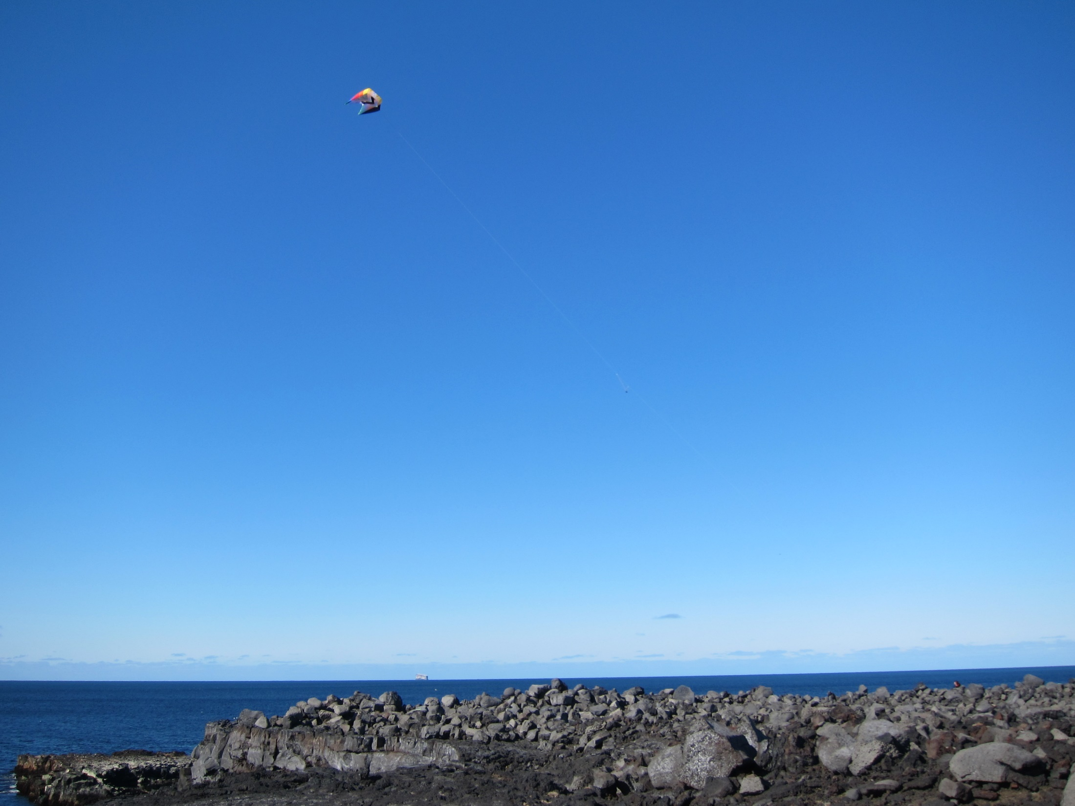
Setting up a morphosedimentary dynamics observatory
kite
camera
operator

Slide 21
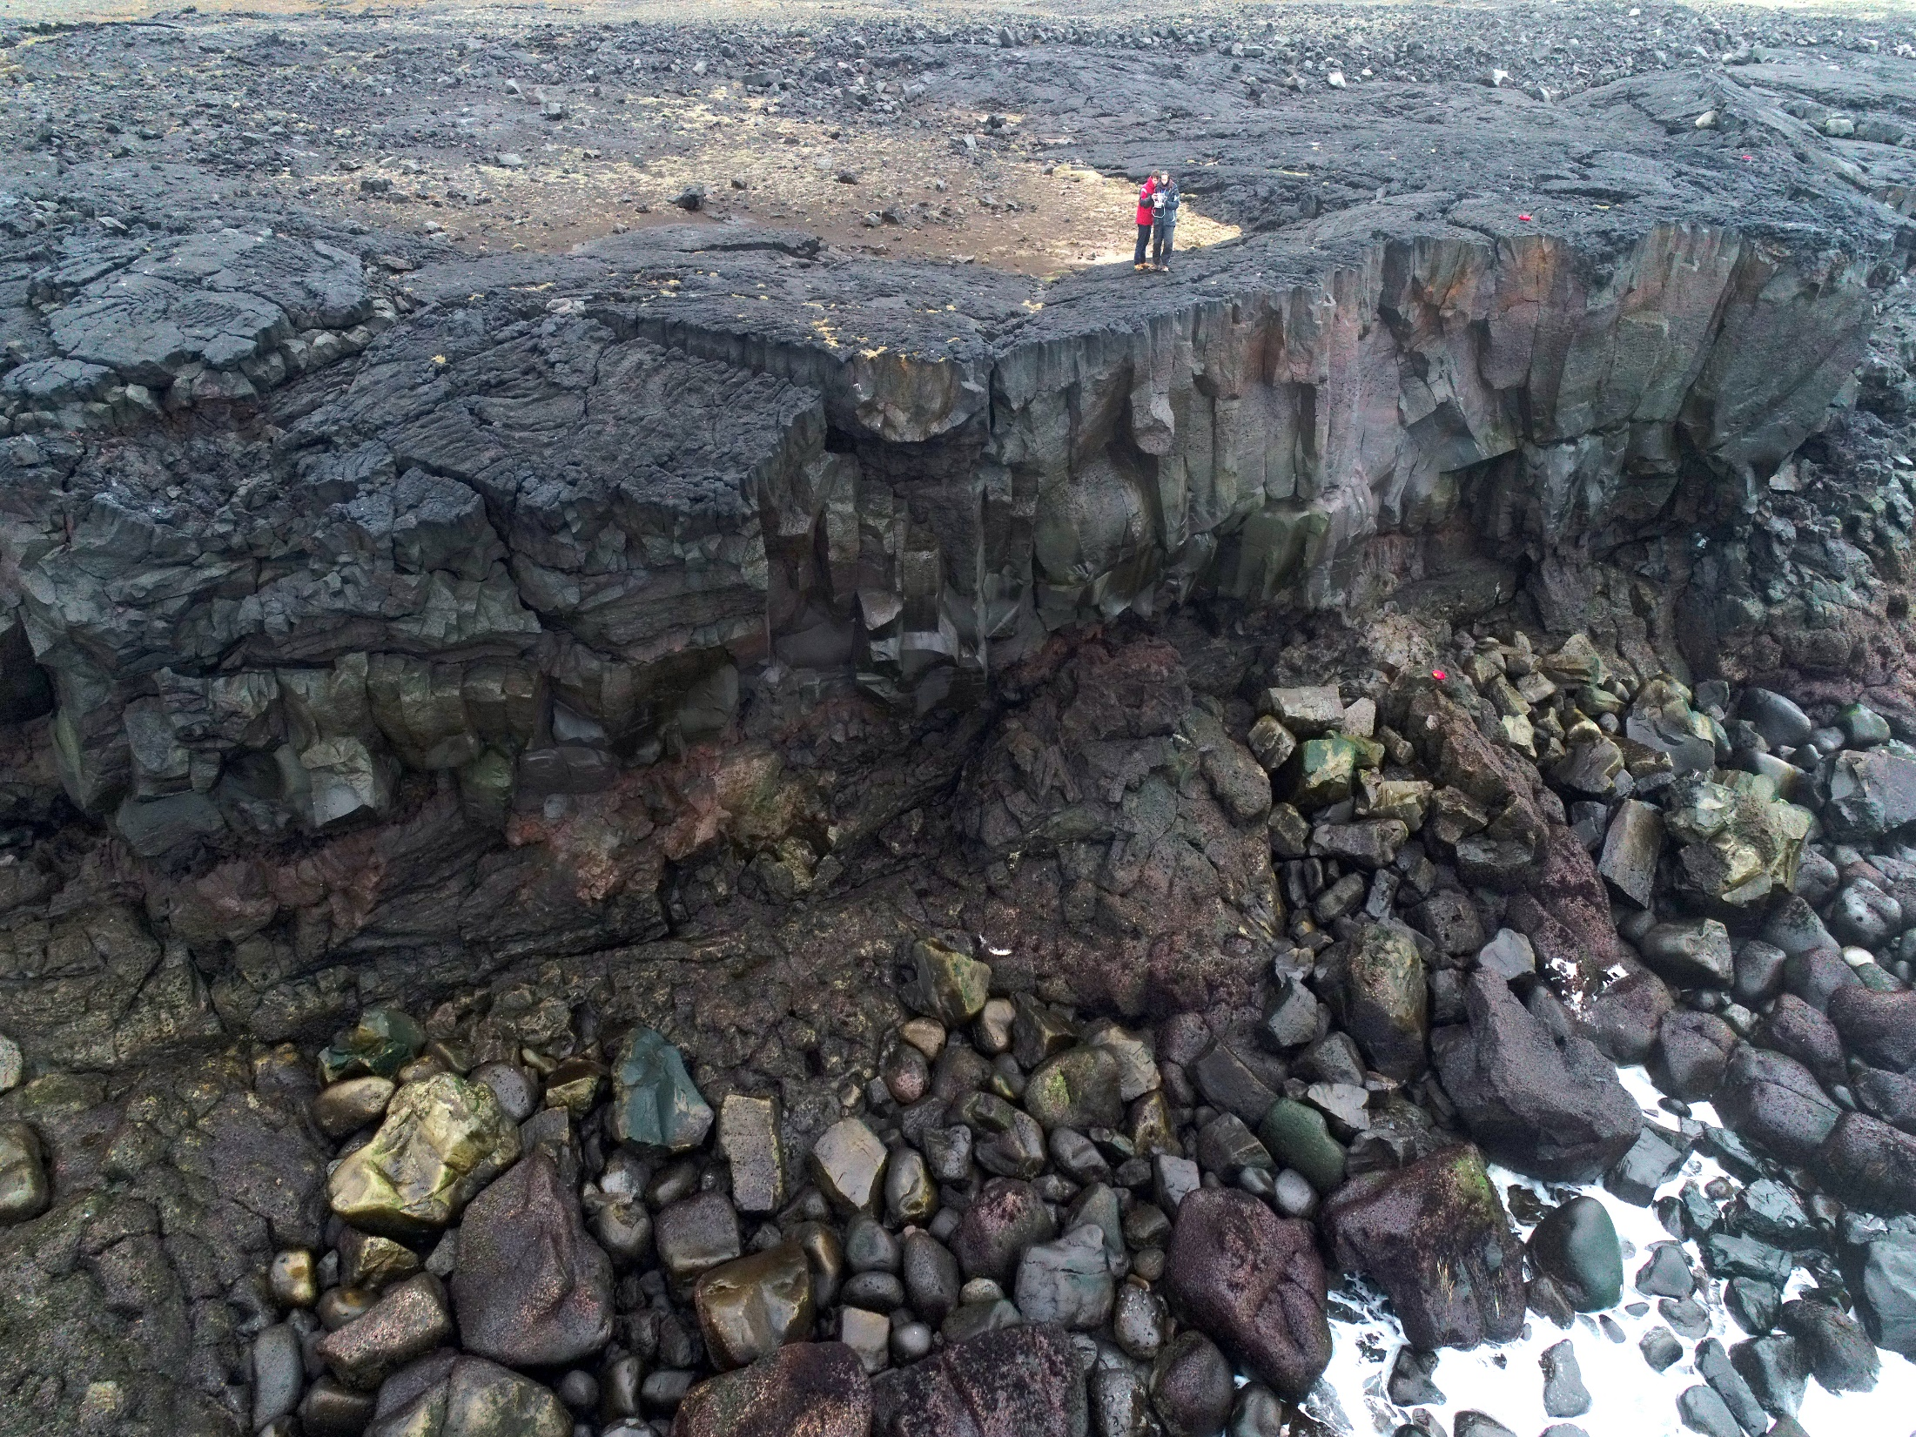
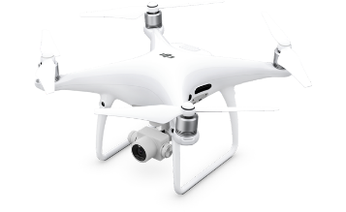
Setting up a morphosedimentary dynamics observatory
vol drone (Selatangar)

Slide 22

Diachronic analysis of annual sediment budgets
site de Reykjanesta

Slide 23
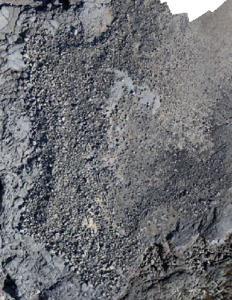
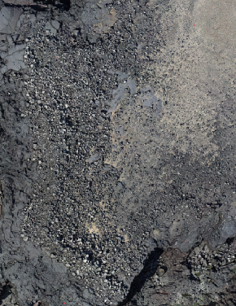
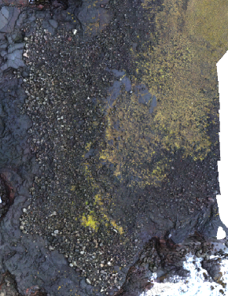
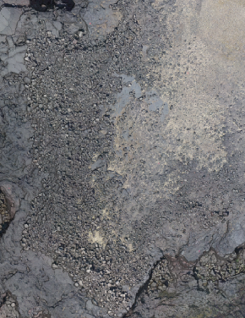
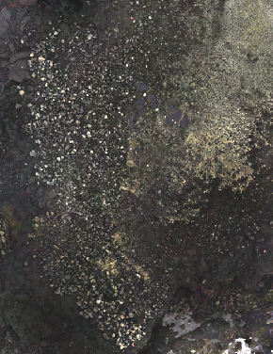
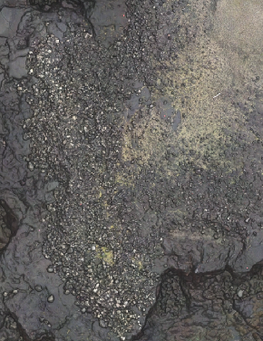
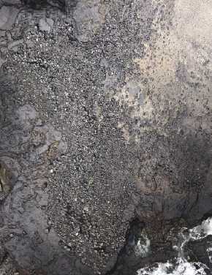
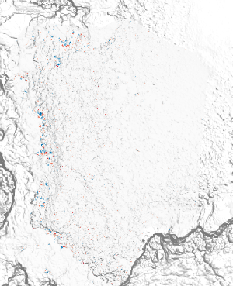
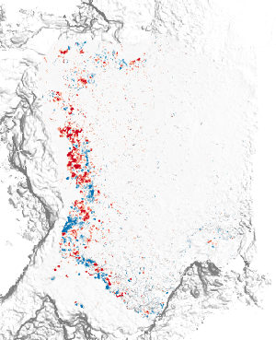
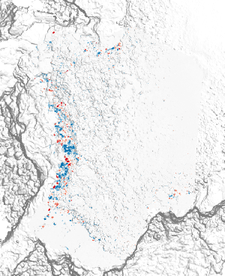
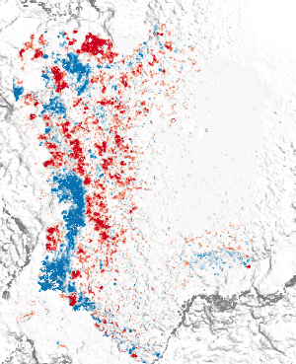
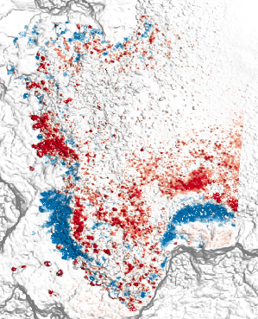
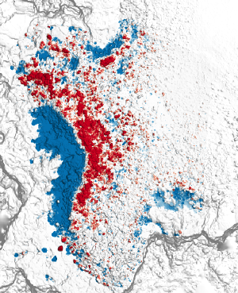
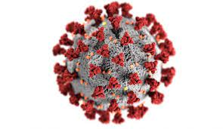
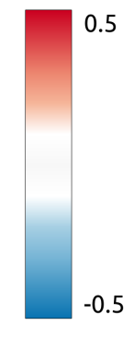
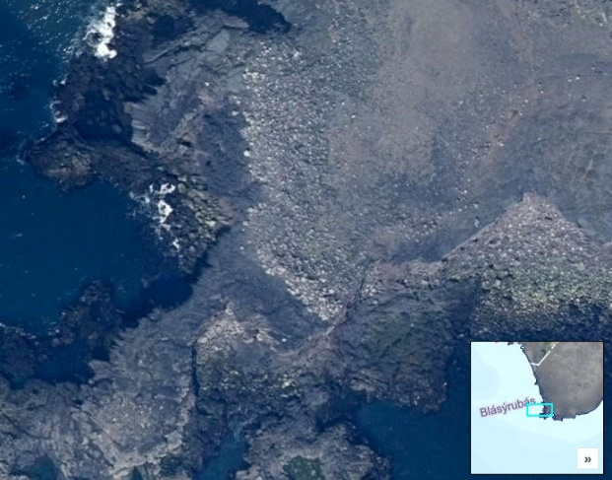
Diachronic analysis of annual sediment budgets
Digital Elevation Model (DEMs)
2015
2016
2017
2018
2019
2021
2022
DOD
2015-2016
DOD
2016-2017
DOD
2017-2018
DOD
2018-2019
DOD
2019-2021
DOD
2021-2022
2020
Topographic change (m)
site de Reykjanesta

Slide 24
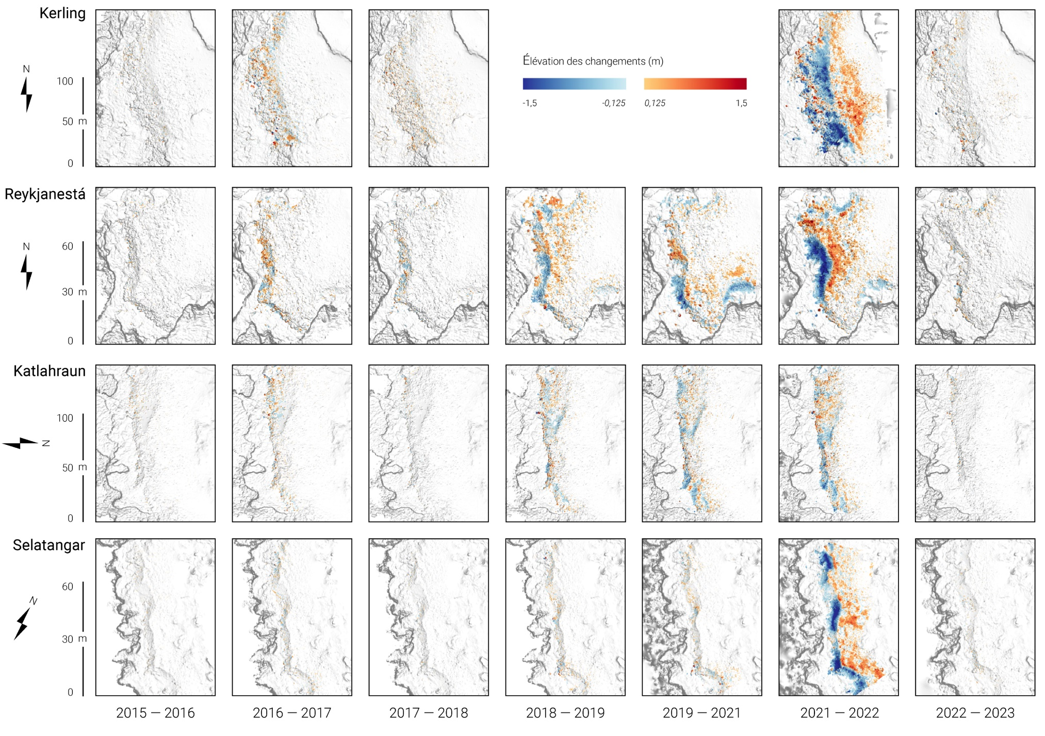
Diachronic analysis of annual sediment budgets
increase of morphological changes ?
calm

Slide 25

Megaboulder barrier of Valahnukur

Slide 26
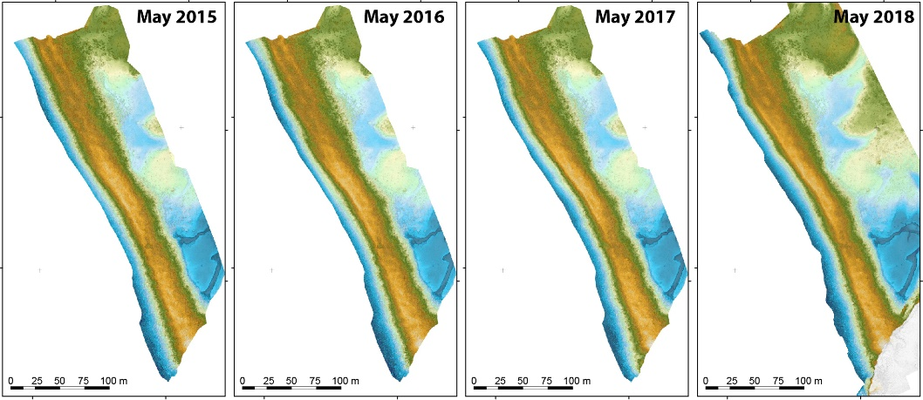
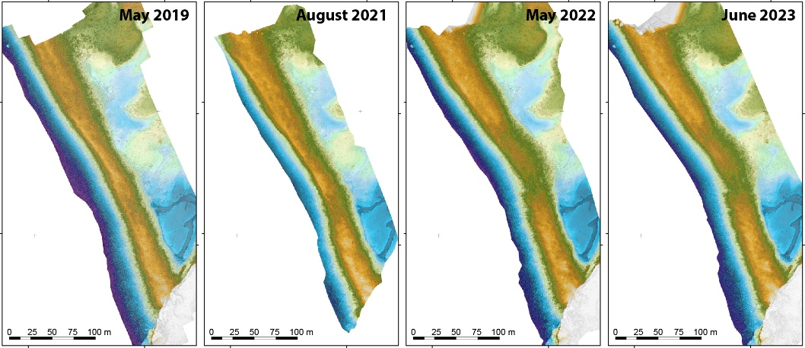

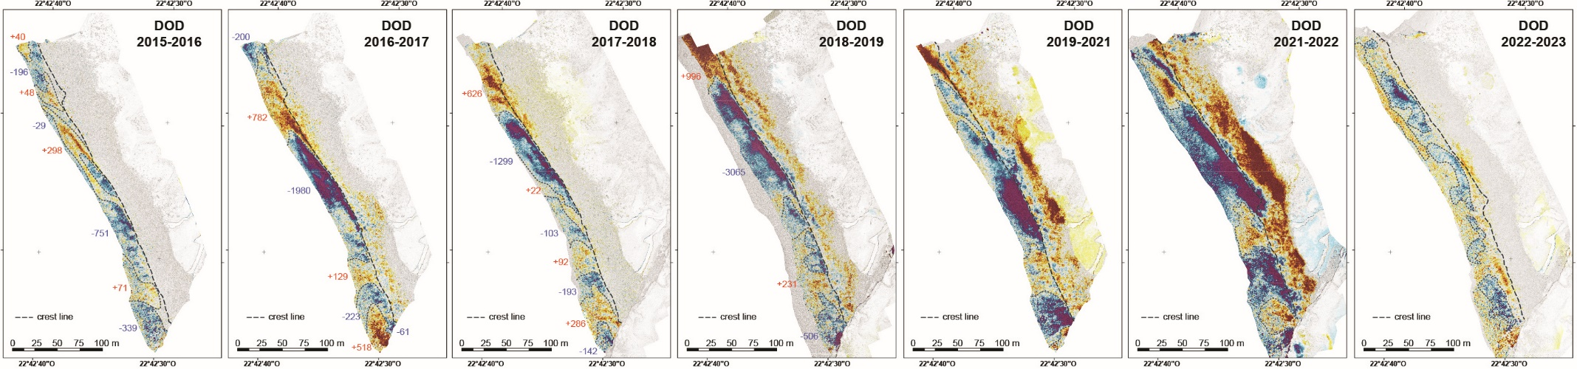
Analyse diachronique des bilans sédimentaires annuels
Digital Elevation Model (DEMs)
increase of morphological changes ?
calm

Slide 27
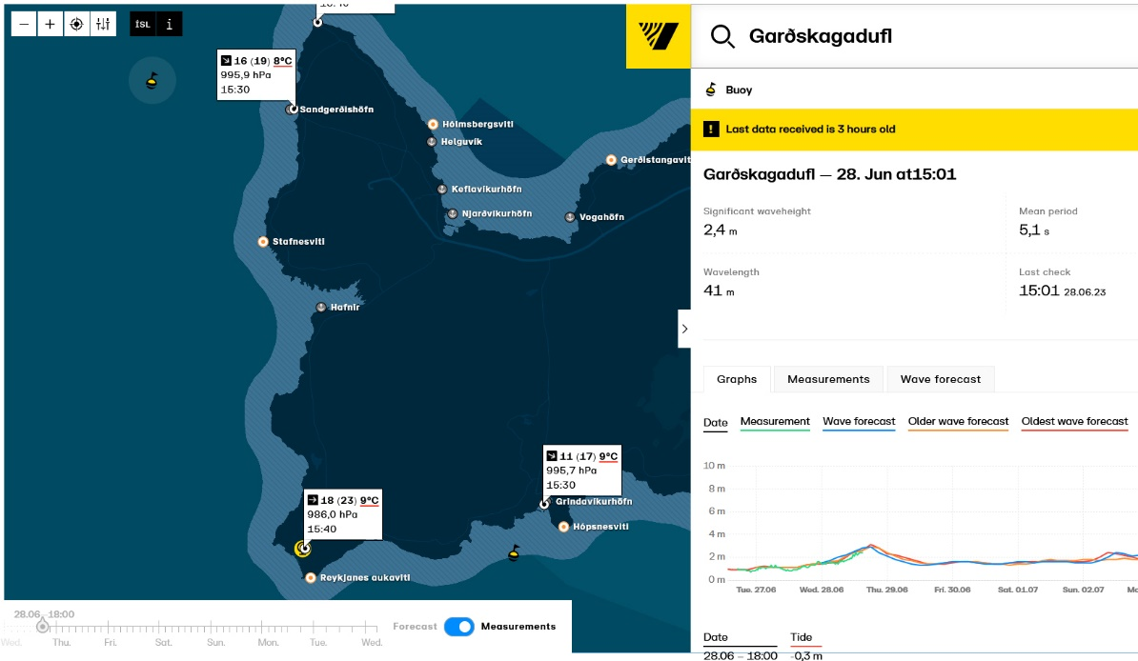
Hydrodynamic analysis
Collaboration with the Vegagerdin (Icelandic Road and Coastal Administration – IRCA – Reykjavik) which manages the wave buoys and tide gauge stations
wave buoy of Garðskagadufl
tide gauge station of
Sandgerði
wave buoy and tide gauge station of Grindavik
https://www.vegagerdin.is/

Slide 28
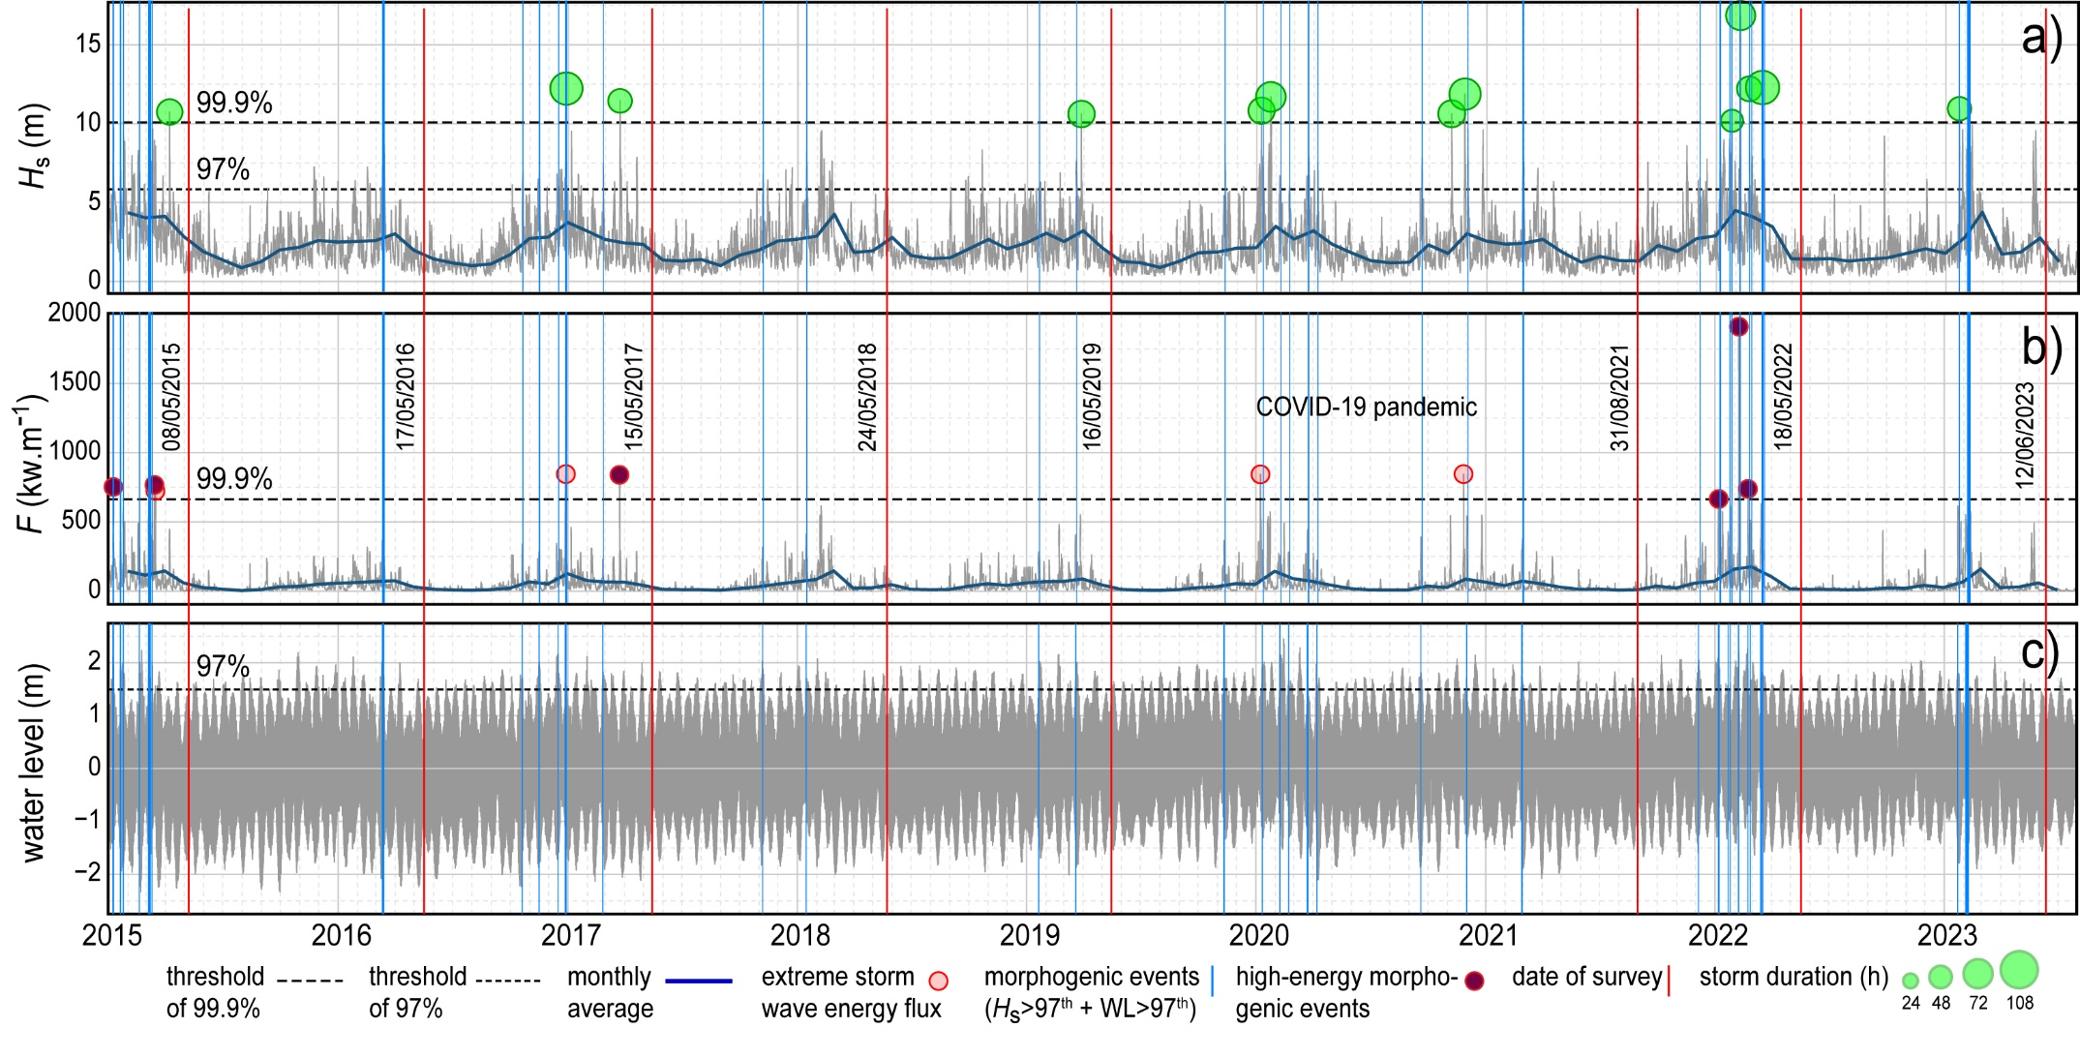
Hydrodynamic analysis
Garðskagadufl wave buoy (north sector)

Slide 29
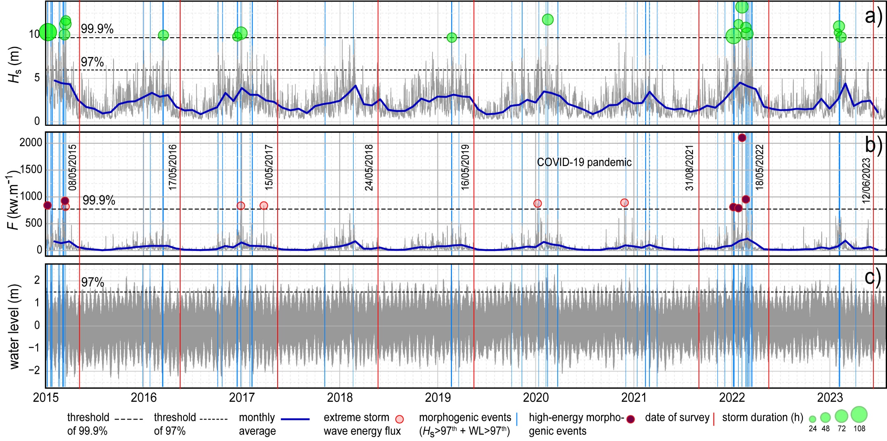
Hydrodynamic analysis
Grindavik wave buoy (south sector)

