Slide 1



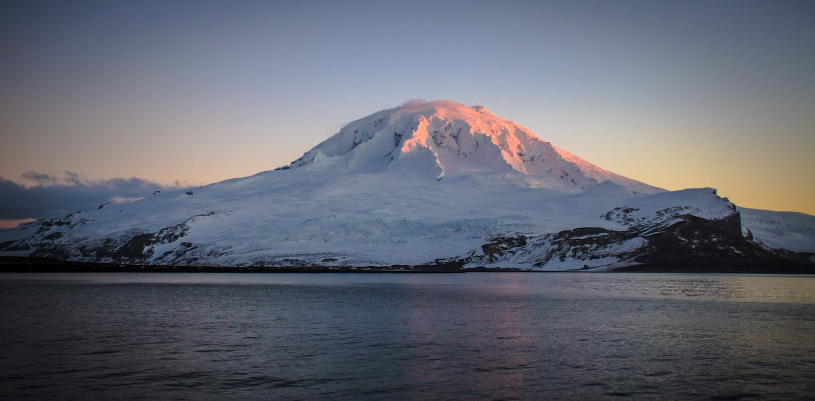
Heard and McDonald: What Barium Isotopes Tell Us About Natural Fertilization Sources ?
Emilie Le Roy
Matt Curnock

Slide 2
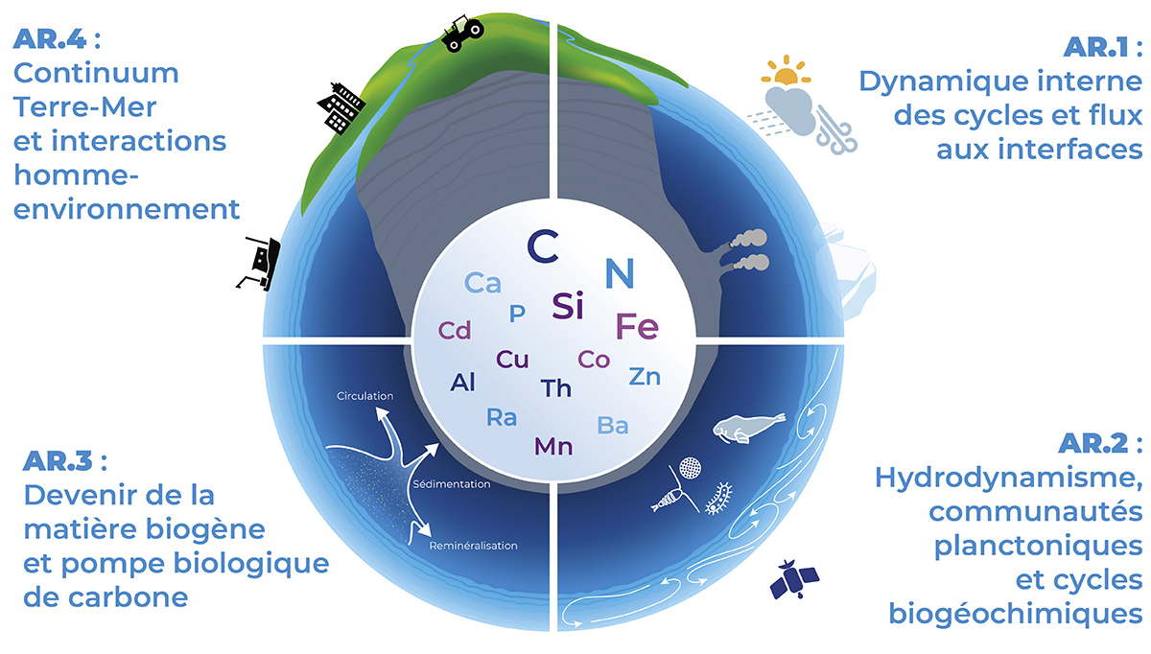
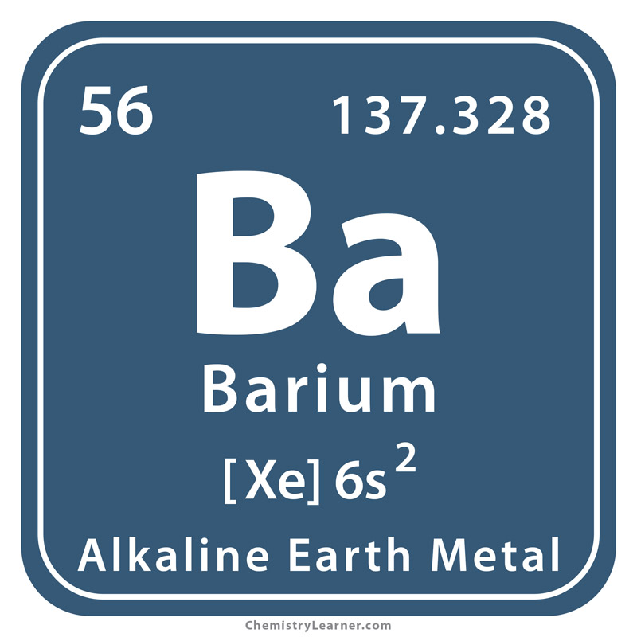
Why study barium in the Ocean?
No known biochemical role
GEOTRACES IDP 2021
Ba connected marine biogeochemistry

Slide 3
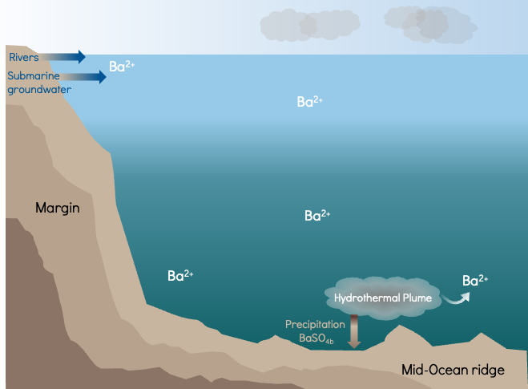
Sources of Barium in the Ocean
Major source : Rivers
Most of the Ocean is undersaturated

Slide 4
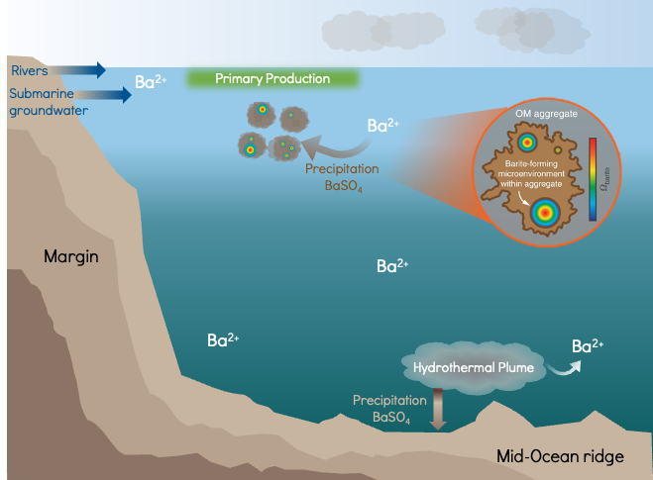
Barium Internal Cycle
Microbial respiration within decaying OM aggregates forms barite-supersaturated microenvironments
➔ Ba precipitation in mesopelagic zone (100- 1000m)

Slide 5
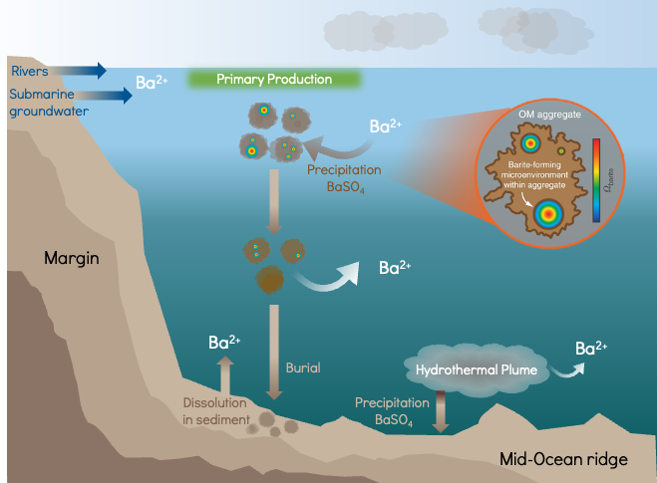
Barium Internal Cycle
➔ Ba start to dissolve

Slide 6
Barium Internal Cycle
Some particulate Ba is buried into deep sediments
Barium may diffuse from sediments

Slide 7
Barium in the Ocean
Modern Ba cycle is either:
Not at steady state
Missing at least one major flux term
Uncertainties on the Ba cycle:
Impact from biological activity
Sources
Particle-solution exchange processes
Ba isotopes = insights on these missing sources and processes

Slide 8
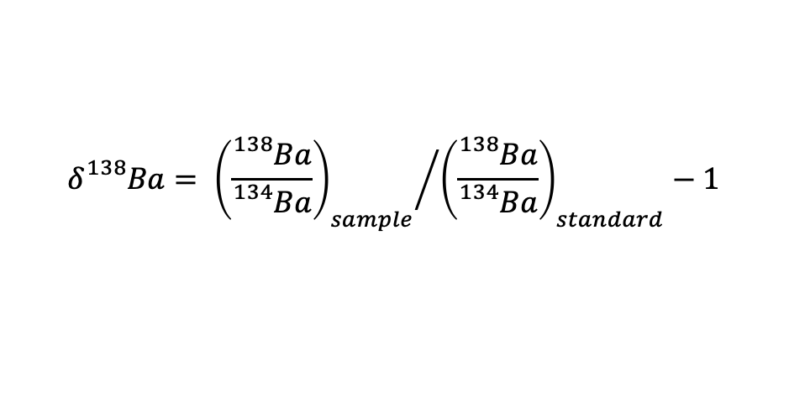
Barium ISOTOPEs : δ¹³⁸Ba
$$δ{}_{}^{138}{Ba}= {{\left(\frac{{}_{}^{138}{Ba}}{{}_{}^{134}{Ba}}\right)}_{sample}}/{{\left(\frac{{}_{}^{138}{Ba}}{{}_{}^{134}{Ba}}\right)}_{standard}}−1$$
➔ Different sources and processes leave distinct Ba isotope signatures δ¹³⁸Ba

Slide 9
Barium ISOTOPEs in the Ocean
Shallow
Deep
Rivers
&
Submarine Groundwater Discharges
Δ¹³⁸Ba_{DBa-Barite}
≈0.5 ‰
Δ¹³⁸Ba_{Sources- Sinks}
≈ 0.2 ‰
Pelagic Barite
Sources
Seawater
Sinks
Mismatch Sources-Sinks = Missing Sources of light δ¹³⁸Ba

Slide 10
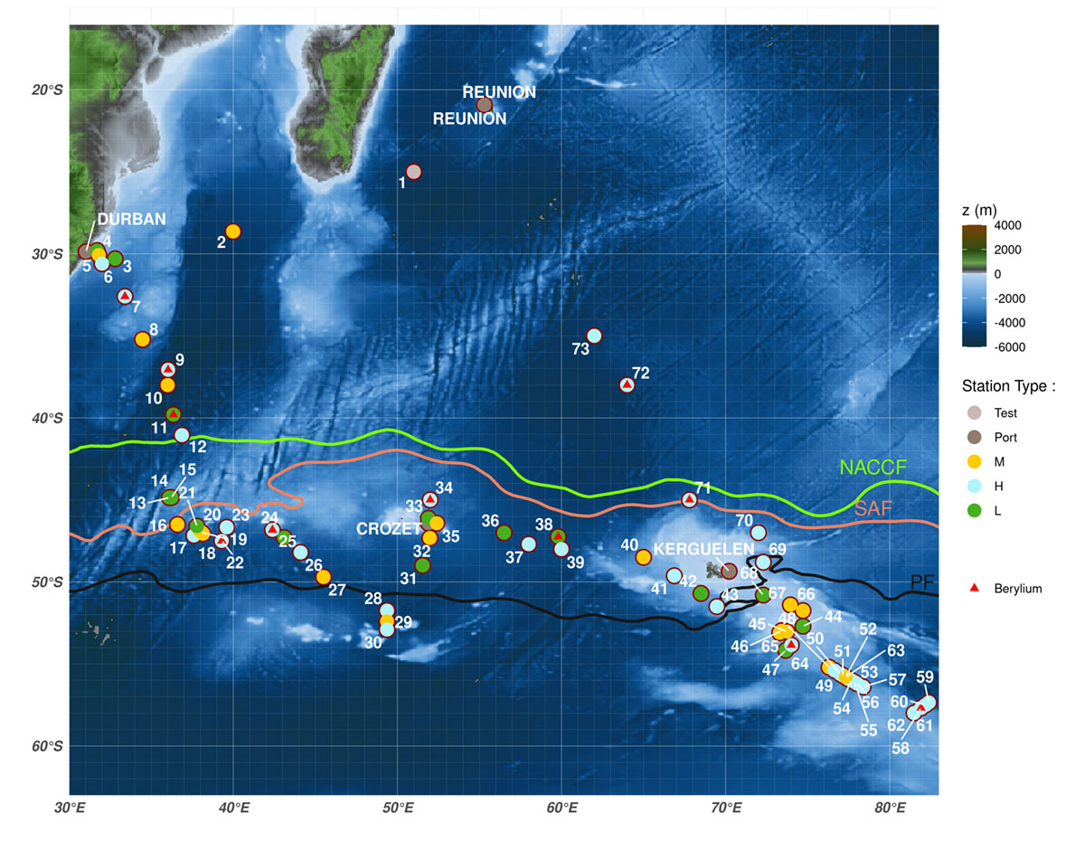
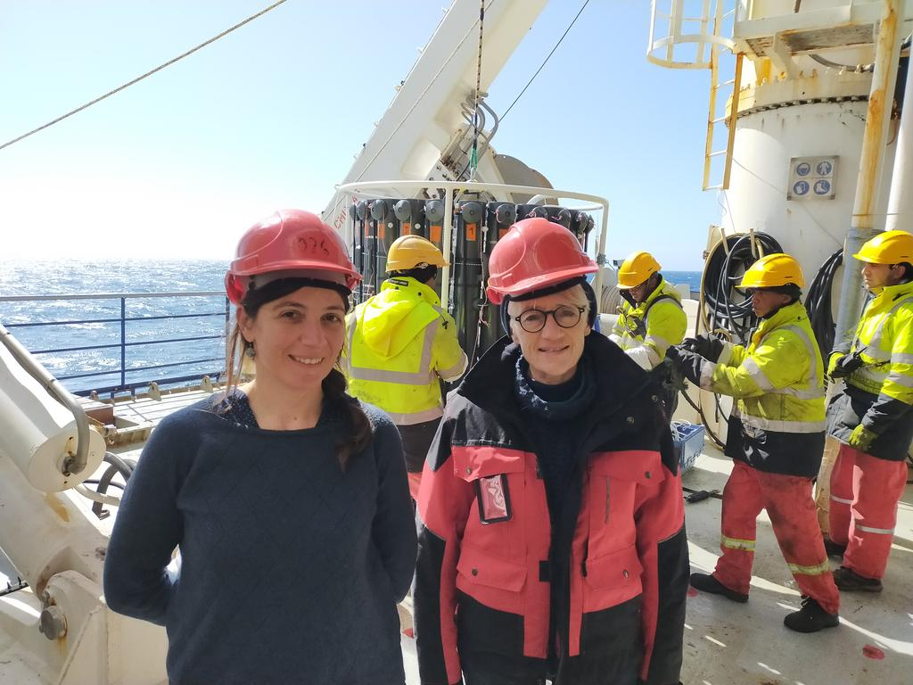

South West Indian GEOTRACES Section (GS02)
January 13th- March 8th 2021
N/O Marion Dufresne
H. Planquette( LEMAR ) & C. Jeandel (LEGOS)

Slide 11
South West Indian GEOTRACES Section (GS02)
January 13th- March 8th 2021
N/O Marion Dufresne
H. Planquette( LEMAR ) & C. Jeandel (LEGOS)

Slide 12
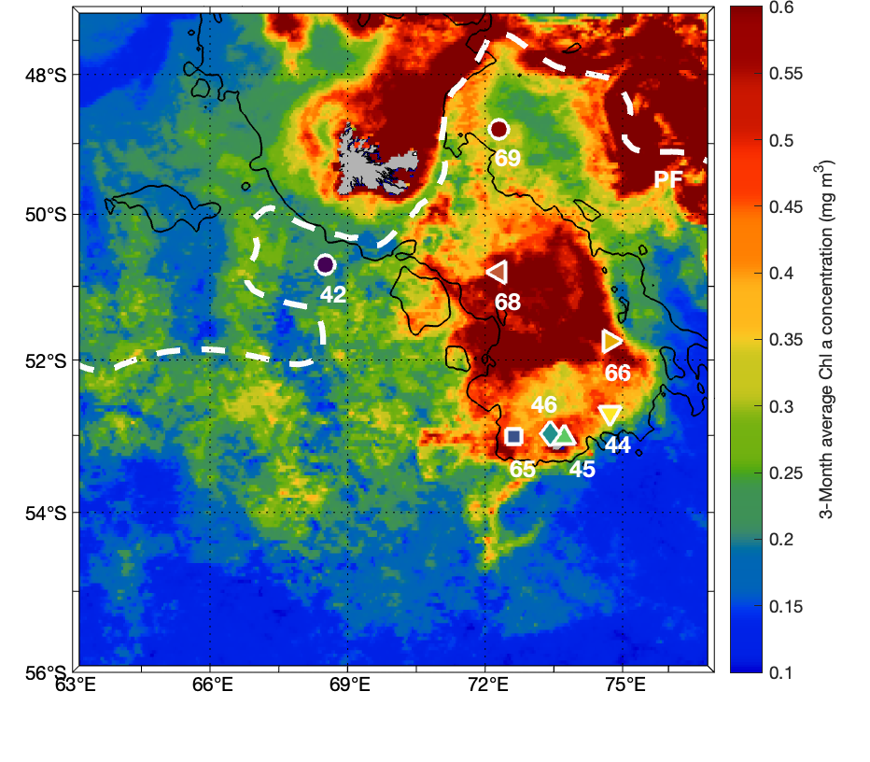
Why FoCUS on the Kerguelen Plateau?
The Southern Ocean is one of the most productive oceanic regions despite being a High Nutrient, Low Chlorophyll (HNLC) zone
Iron is a key limiting nutrient for phytoplankton growth in these waters
A Natural Iron Fertilization Hotspot
Coming from Heard and McDonald Island

Slide 13
Natural fertilization Hypothesis
Glacier
Fluvial and glacial runoff
Volcanic
Island
Sedimentary
Inputs
High Chl a
Transport
Plateau

Slide 14
Natural fertilization Hypothesis
Glacier
Fluvial and glacial runoff
Volcanic
Island
Sedimentary
Inputs
High Chl a
Transport
Plateau
Heard and McDonald ➔ Ideal for Investigating Barium Dynamics
Could these sources represent a missing link in the marine Ba budget?

Slide 15
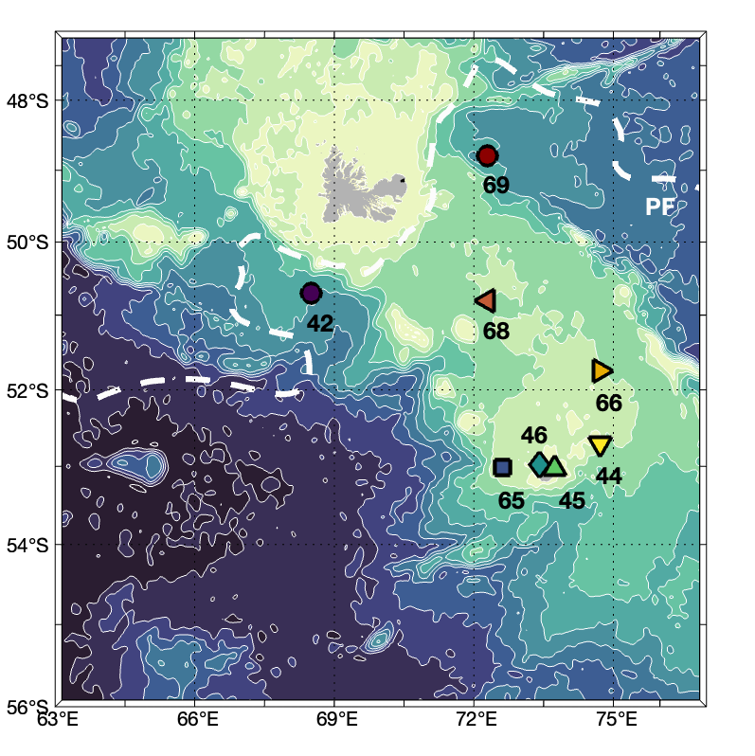
Circulation on the plateau

Slide 16
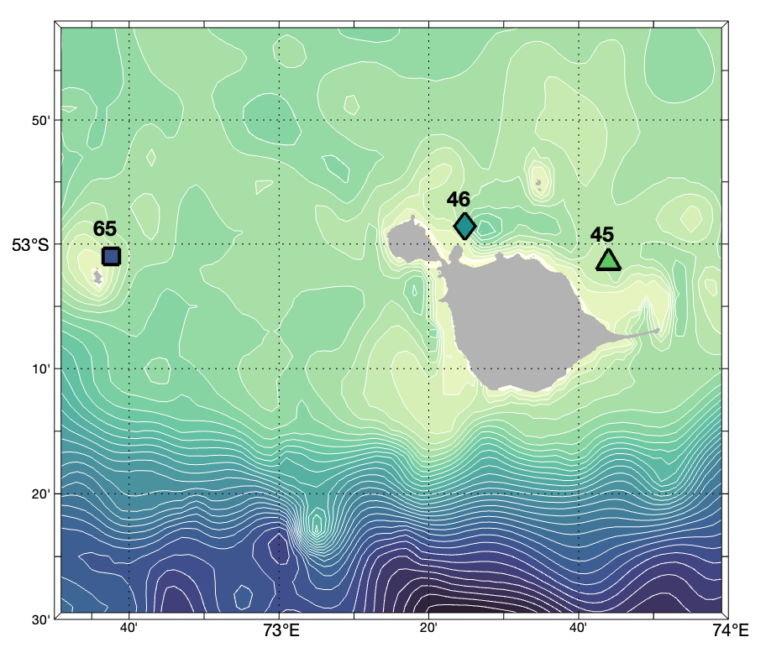
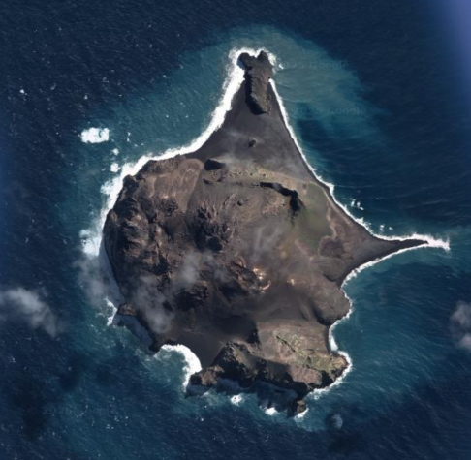
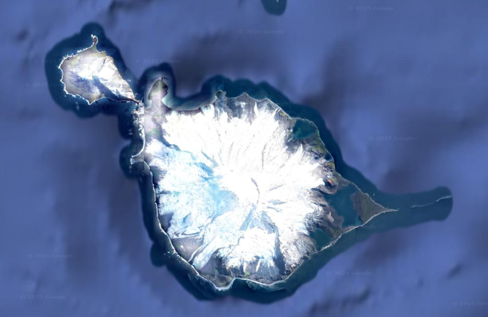
Circulation on the plateau
McDonald
Heard
McDonald
Heard

Slide 17
Two IsLANDs : Two Stories
McDonald
Heard
 | [Ba] |  | δ¹³⁸Ba
Heard Island | + 8 nmol L⁻¹ | + 10 % | Heavier | +0.10 ‰
McDonald | + 40 nmol L⁻¹ | +50% | Lighter | - 0.40 ‰

Slide 18
Two IsLANDs : Two Stories
McDonald
Heard
Two similar Islands ➔ Two δ¹³⁸Ba Signatures
➔ Two Distinct Sources
δ¹³⁸Ba distinguish sources in such similar island systems ?

Slide 19
McDonald Island
McDonald Island
Presence of lithogenic particles
Up to 94 % lithogenic ➔ Resupension of local sediments ?
Notes:
Dissolution

Slide 20
McDonald Island
McDonald Island
Presence of lithogenic particles
Up to 94 % lithogenic ➔ Resupension of local sediments ?
Plateau Sediments
δ¹³⁸Ba = 0.03 ‰
Porewater
Exchange
Plateau Sediments
δ¹³⁸Ba = 0.03 ‰
Notes:
Dissolution

Slide 21
McDonald Island
McDonald Island
Resupension & Dissolution Δ¹³⁸Ba = 0.00 ‰
Presence of lithogenic particles
Up to 94 % lithogenic ➔ Resupension of local sediments
Plateau Sediments
δ¹³⁸Ba = 0.03 ‰
Porewater
Exchange
Plateau Sediments
δ¹³⁸Ba = 0.03 ‰
Plateau Sediments
δ¹³⁸Ba = 0.03 ‰
Notes:
Dissolution

Slide 22
McDonald Island
McDonald Island
Resupension & Dissolution Δ¹³⁸Ba = 0.00 ‰
δ¹³⁸Ba
= 0.03 ‰
Presence of lithogenic particles
Up to 94 % lithogenic ➔ Resupension of local sediments
Plateau Sediments
δ¹³⁸Ba = 0.03 ‰
Porewater
Exchange
Plateau Sediments
δ¹³⁸Ba = 0.03 ‰
Plateau Sediments
δ¹³⁸Ba = 0.03 ‰
Notes:
Dissolution

Slide 23
McDonald Island
McDonald Island
Resupension & Dissolution Δ¹³⁸Ba = 0.00 ‰
δ¹³⁸Ba
= 0.03 ‰
Porewater
Exchange Δ¹³⁸Ba = 0.20 ‰
Plateau Sediments
δ¹³⁸Ba = 0.03 ‰
Porewater
Exchange
Plateau Sediments
δ¹³⁸Ba = 0.03 ‰
Plateau Sediments
δ¹³⁸Ba = 0.03 ‰
Notes:
Dissolution

Slide 24
McDonald Island
McDonald Island
Resupension & Dissolution Δ¹³⁸Ba = 0.00 ‰
δ¹³⁸Ba
= 0.03 ‰
Porewater
Exchange Δ¹³⁸Ba = 0.20 ‰
δ¹³⁸Ba = 0.23 ‰
Plateau Sediments
δ¹³⁸Ba = 0.03 ‰
Porewater
Exchange
Plateau Sediments
δ¹³⁸Ba = 0.03 ‰
Plateau Sediments
δ¹³⁸Ba = 0.03 ‰
Notes:
Dissolution

Slide 25
McDonald Island
McDonald Island
δ¹³⁸Ba = 0.23 ‰
Resupension & Dissolution Δ¹³⁸Ba = 0.00 ‰
δ¹³⁸Ba
= 0.03 ‰
Diffusion
Δ¹³⁸Ba = 0.00 ‰
Porewater
Exchange Δ¹³⁸Ba = 0.20 ‰
δ¹³⁸Ba = 0.23 ‰
Plateau Sediments
δ¹³⁸Ba = 0.03 ‰
Porewater
Exchange
Plateau Sediments
δ¹³⁸Ba = 0.03 ‰
Notes:
Dissolution

Slide 26
McDonald Island
McDonald Island
Resupension & Dissolution Δ¹³⁸Ba = 0.00 ‰
δ¹³⁸Ba = 0.23 ‰
δ¹³⁸Ba
= 0.03 ‰
Diffusion
Δ¹³⁸Ba = 0.00 ‰
Porewater
Exchange Δ¹³⁸Ba = 0.20 ‰
δ¹³⁸Ba = 0.23 ‰
Plateau Sediments
δ¹³⁸Ba = 0.03 ‰
Porewater
Exchange
Plateau Sediments
δ¹³⁸Ba = 0.03 ‰
Diffusion of light δ¹³⁸Ba from Lithogenic Sediment
Notes:
Dissolution

Slide 27
Heard island

Slide 28
Heard island
More particles observed around Heard than McDonald
Particles enriched in Fe and Mn oxides, likely sourced from glacial runoff

Slide 29
Heard island
Adsorption
onto oxides Δ¹³⁸Ba = -0.31 ‰
More particles observed around Heard than McDonald
Particles enriched in Fe and Mn oxides, likely sourced from glacial runoff
Ba adsorption onto oxides:
Light Ba isotopes preferentially bind to oxides
Heavier isotopes remain in seawater, leading to enriched δ¹³⁸Ba

Slide 30
Heard island
Ba inputs from glacial runoff, with isotope fractionation driven by adsorption onto Fe and Mn oxide particles

Slide 31
Conclusions and implication
Two similar islands but two distinct Ba isotopic signatures.
1) McDonald
Sedimentary inputs
via resuspension and/or diffusion
→ lighter δ¹³⁸Ba → Missing source ?
2) Heard
Glacial runoff : input enriched in Fe and Mn oxides
selective adsorption of Ba onto oxides
→ heavier δ¹³⁸Ba

Slide 32
Conclusions and implications
Two similar islands but two distinct Ba isotopic signatures.
1) McDonald
Sedimentary inputs
via resuspension and/or diffusion
→ lighter δ¹³⁸Ba → Missing source ?
2) Heard
Glacial runoff : input enriched in Fe and Mn oxides
selective adsorption of Ba onto oxides
→ heavier δ¹³⁸Ba
Next : How do these signals travel across the Kerguelen Plateau?

Slide 33
Conclusions and implications
Two similar islands but two distinct Ba isotopic signatures.
1) McDonald
Sedimentary inputs
via resuspension and/or diffusion
→ lighter δ¹³⁸Ba → Missing source ?
2) Heard
Glacial runoff : input enriched in Fe and Mn oxides
selective adsorption of Ba onto oxides
→ heavier δ¹³⁸Ba
Next : How do these signals travel across the Kerguelen Plateau?
➔ Spatial variability of the δ¹³⁸Ba
➔ Ba isotopes provide a useful tool for tracing the sources and processes for the Ba marine cycle
Particle-solution interactions play an important role in the δ¹³⁸Ba

